Slide 1
Circle Time Routines
First Circle Social/Social Studies/Math | Second Circle ABC Circle/Science
Morning Song Greeting our Friends Social Lesson Transition to Wash hands for Breakfast | Movement Song ABC Song Book Reading Transition Game to Wash hands for Snack

Slide 2
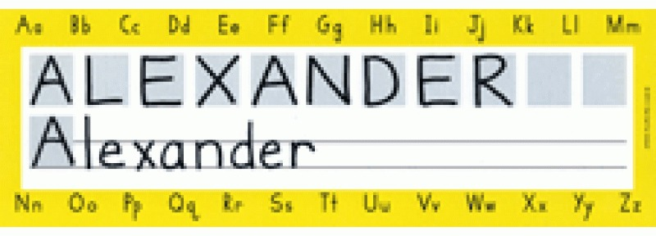
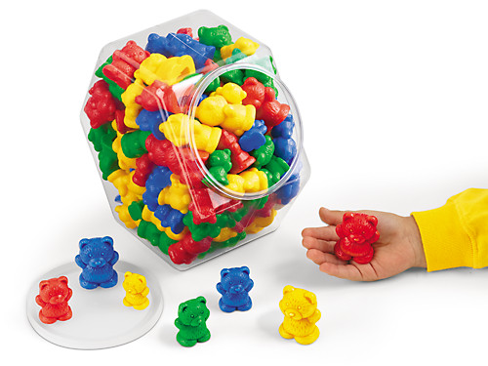
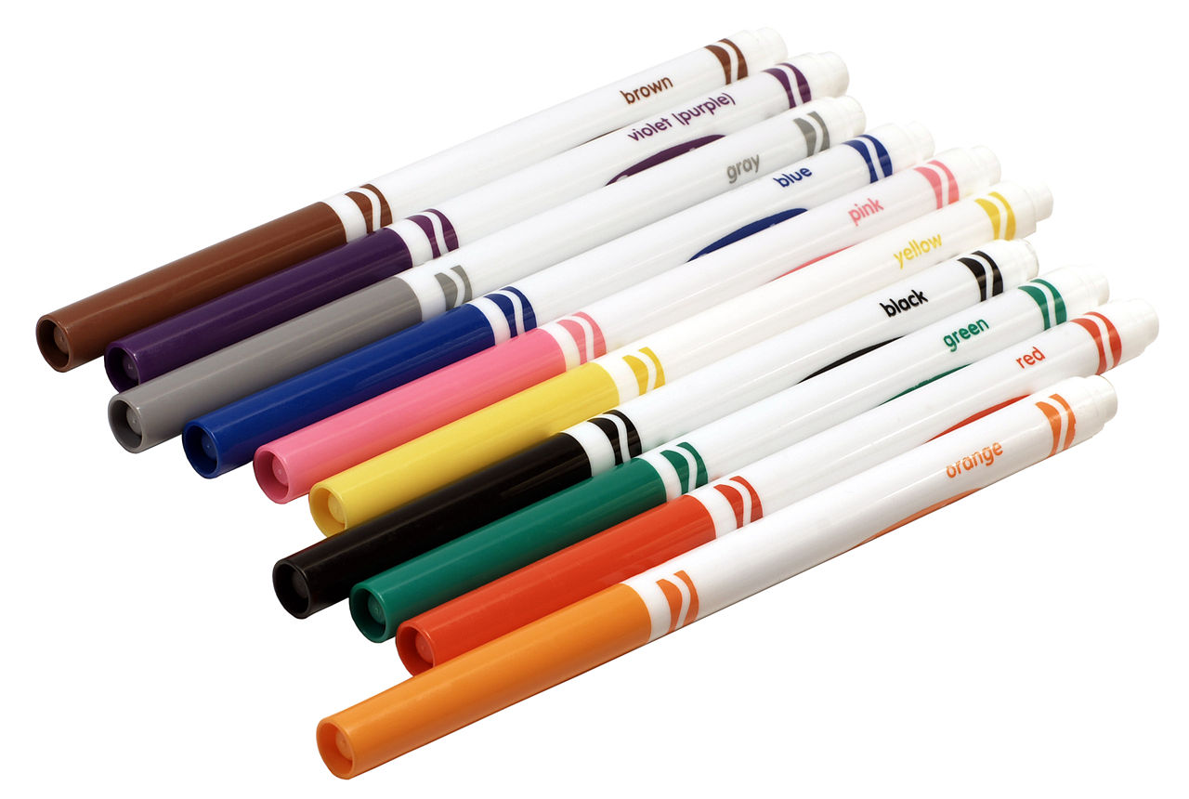
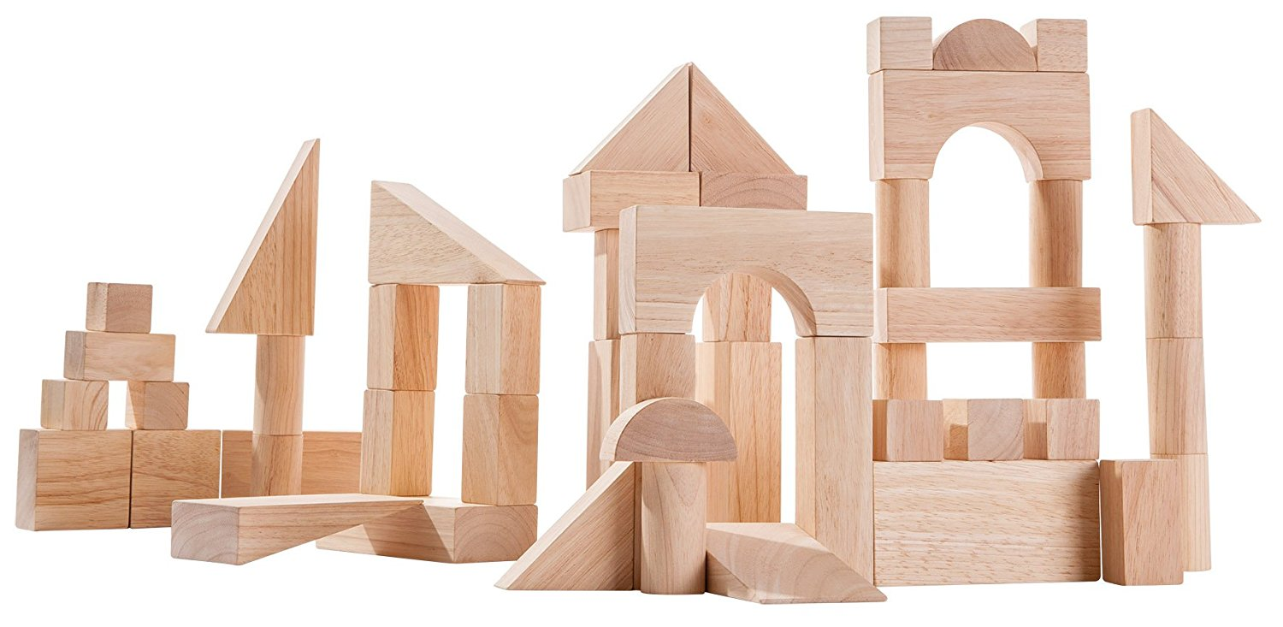
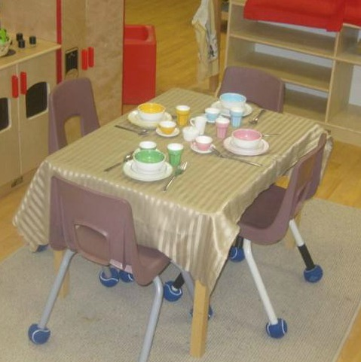
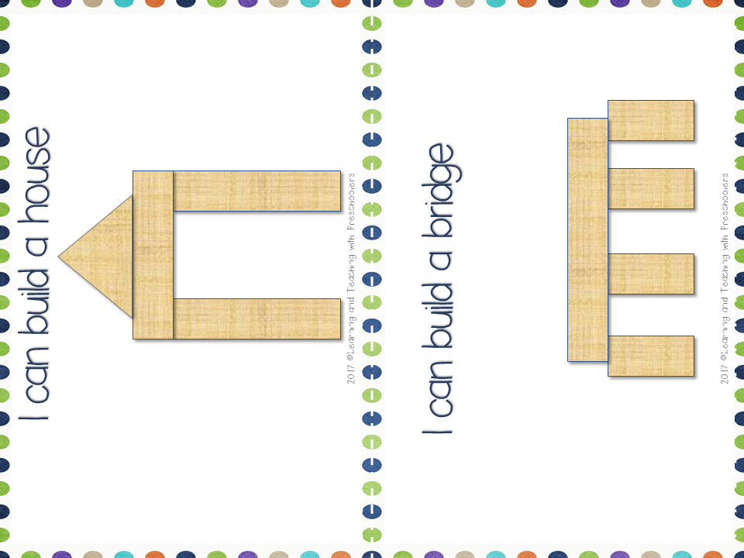
Changing
the
July
Theme: _____________________
Writing Center
Math Center
Introduce Name Plates
Introduce how to use
Markers
Introduce how to use math counters.
How to put counters away
Block Center
Dramatic Play
Introduce how to use wooden blocks.
Introduce how to set the table.
How to put blocks away
Introduce how to put all the items away.

Slide 3
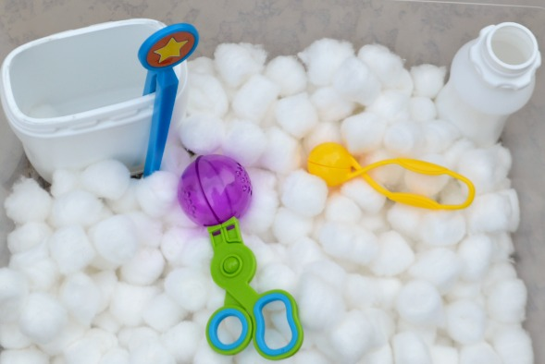
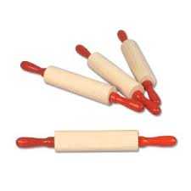
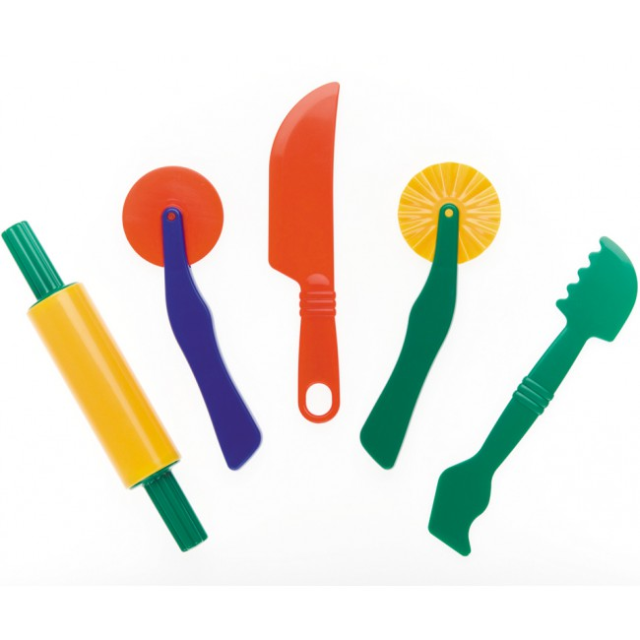
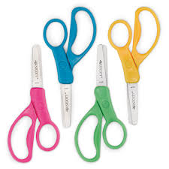
Keeping them engaged
Centers
Date: _____________________
Science Center
Sensory Table
Introduce how to use the sensory table.
Closed
Cotton ball Scoop and Pinch
Play Dough
Art Center
Introduce how to use play dough rollers and cutters.
Introduce how to use scissors with paper strips
How to put materials away
^Learning and Teaching with Preschoolers

Slide 4
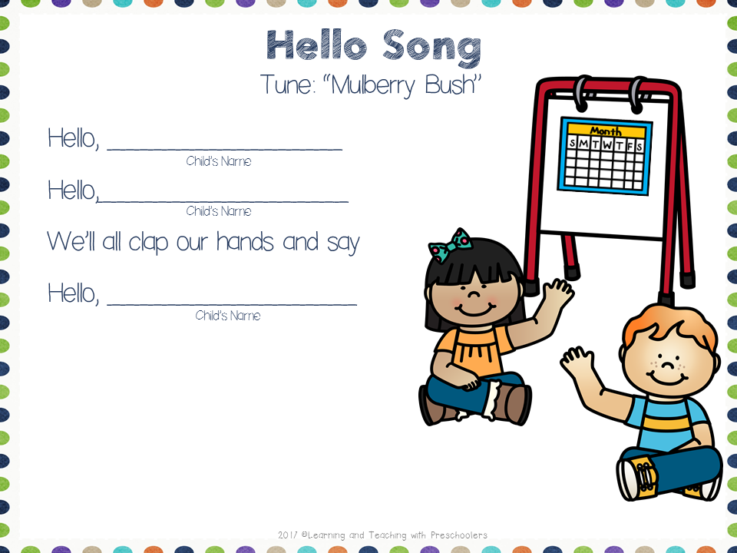
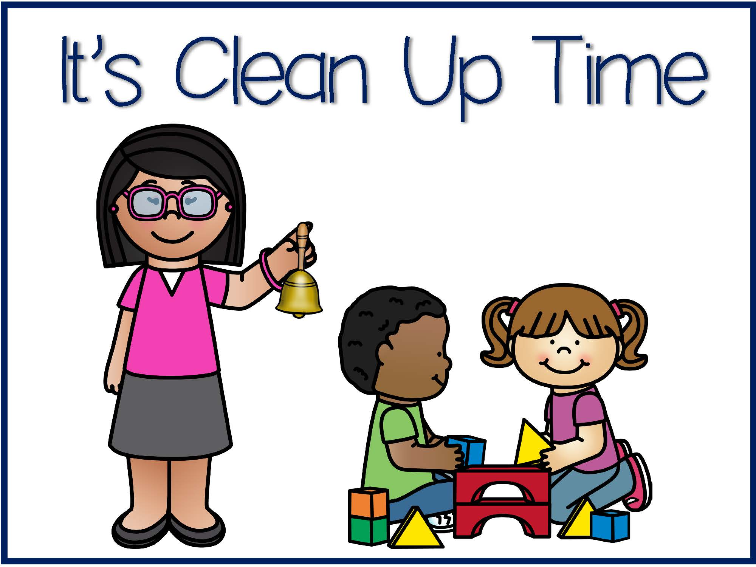
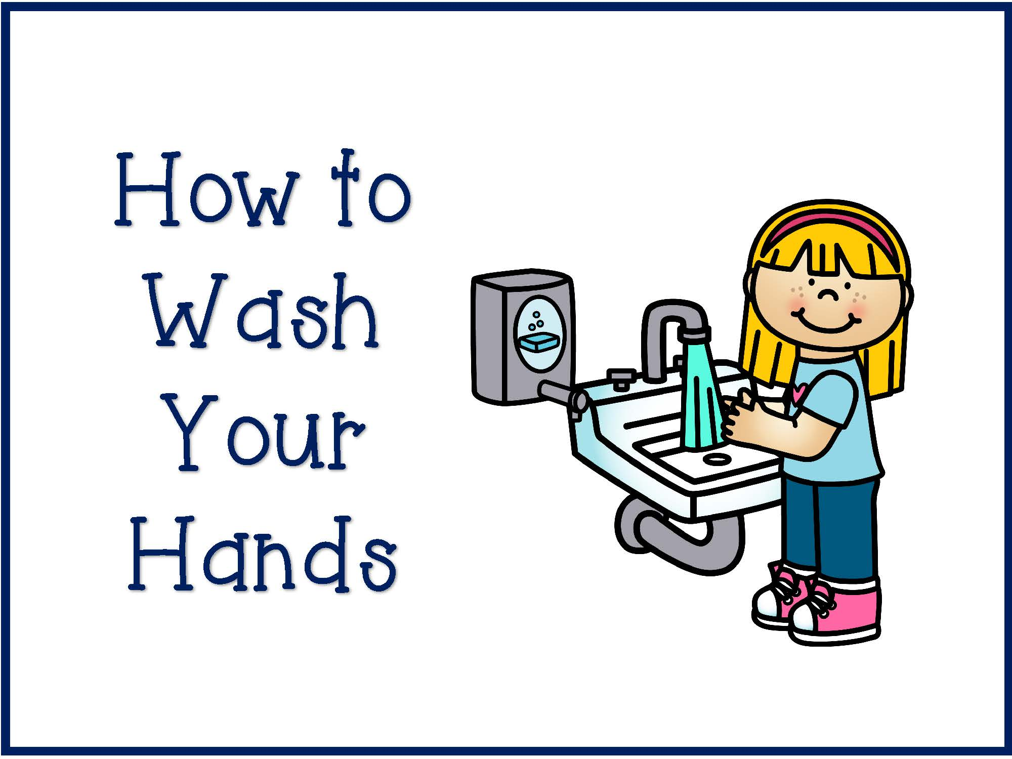
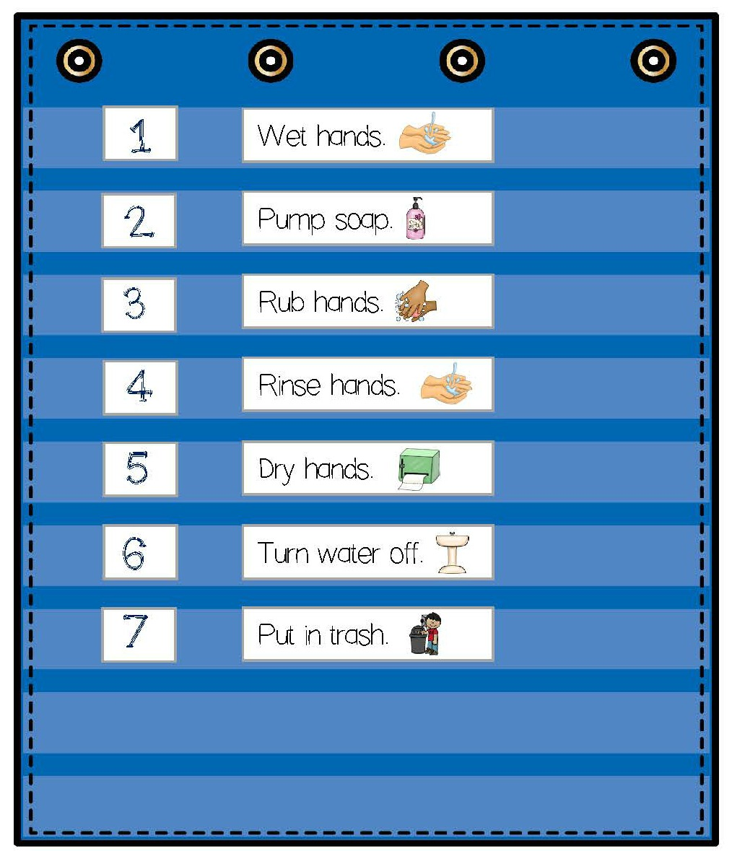
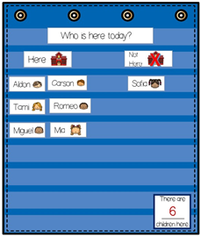
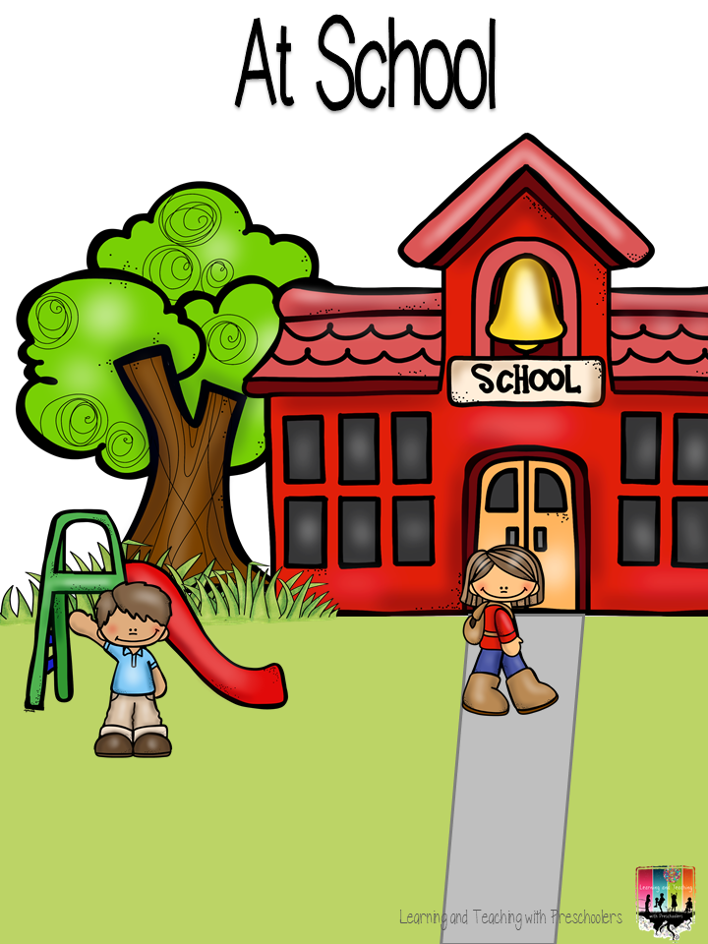
Theme:____________
Monday | Tuesday | Wednesday
Social /Social Studies /Math Circle
ABC Circle/Science
Social Skills How to say Hello to your friends. Hello song Read: How to Wash Your Hands Math Who is Here? Transition: Hoop Hop | Social Science Read: It’s Clean Up Time Review hand washing with pocket chart story Math Transition: Roll and Catch the Ball | Social Skills Who’s Name is It? Class book children’s names with pictures Transition: Who’s Name is it?
ABC Sing ABC Song with Cards Read: At School Transition: Picture Match | Science How Germs Spread Transition: ‘Who’s name is it? | ABC Sing ABC Song with Cards Read: Transition: Walk the tight rope

Slide 5
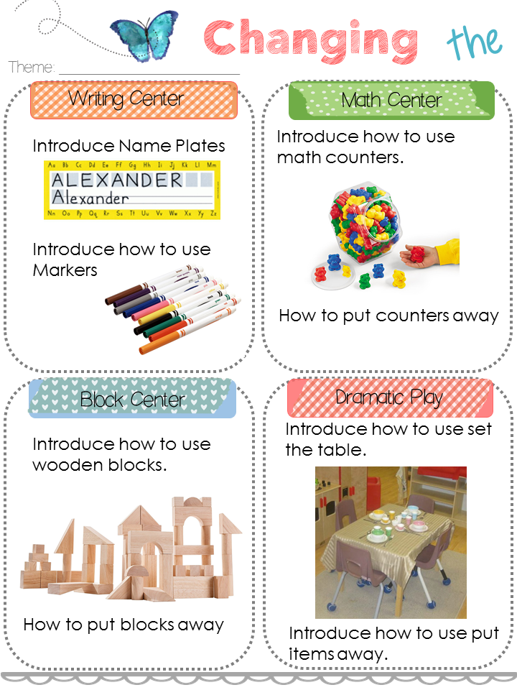
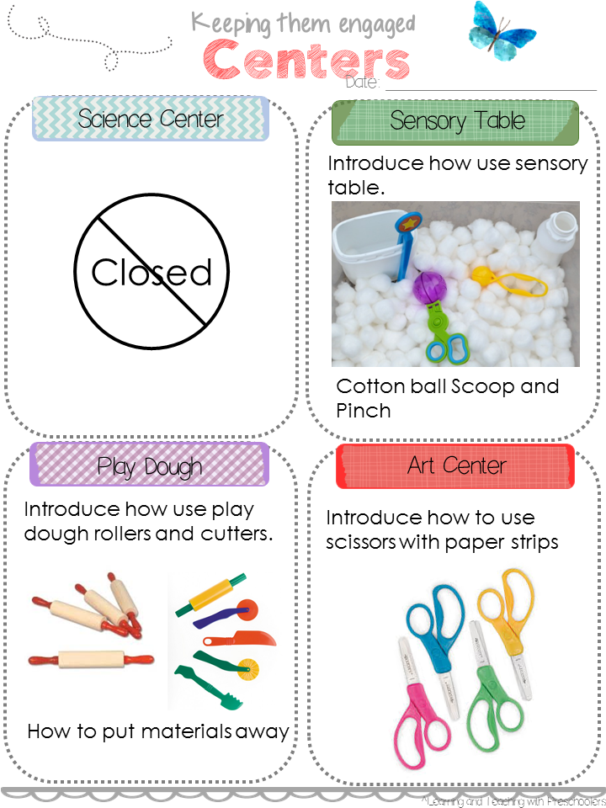
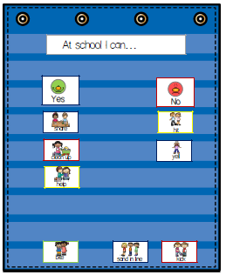
Thursday | Friday | Worktime
Social /Social Studies /Math Circle
ABC Circle/Science
Social Skills Song: Follow the Rules Math Transition: Hoop Hop | Social Skills Read: Math Transition: Roll and Catch the Ball | Introduce the Centers
ABC Sing ABC Song with Cards Pocket Chart At School I Can Transition: Picture Match | Shared Writing Sentence Frame Favorite part of the day is Transition: Who’s Name is it?

Slide 6
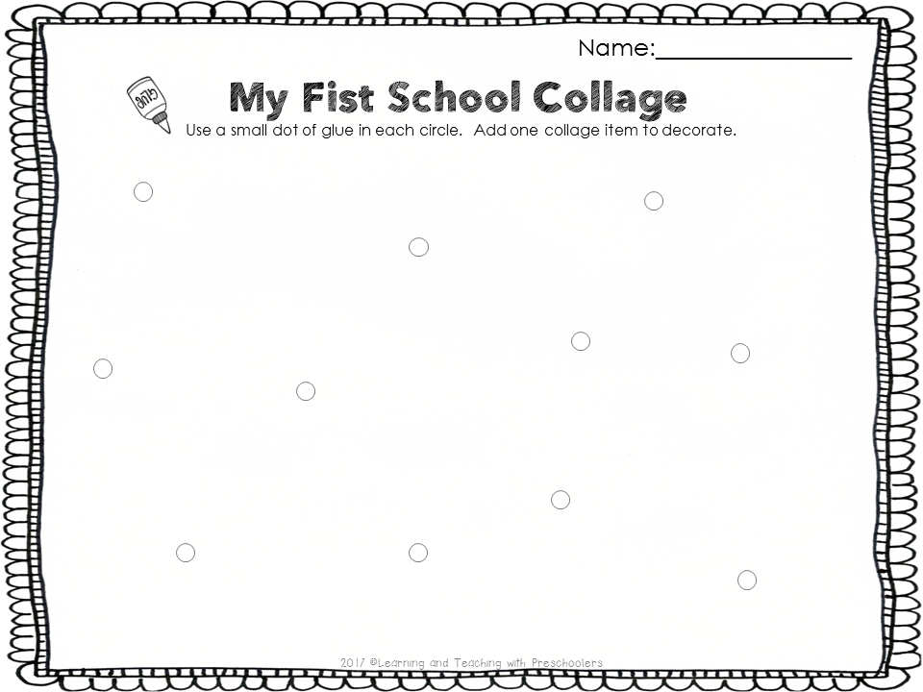
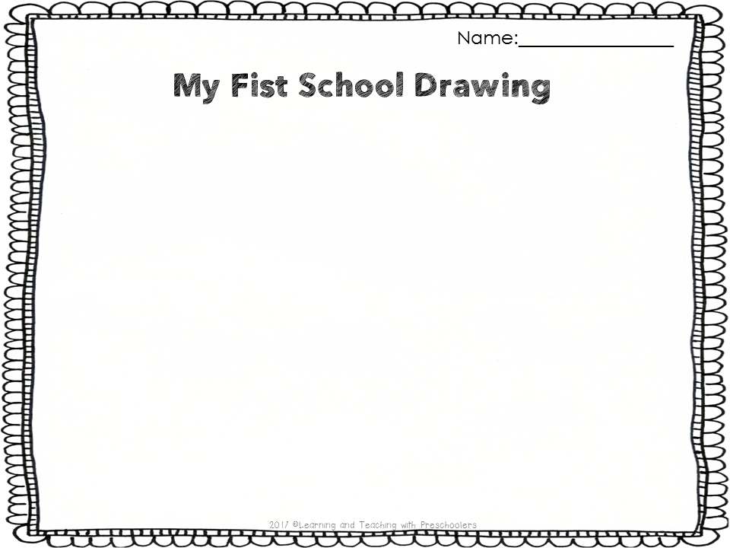
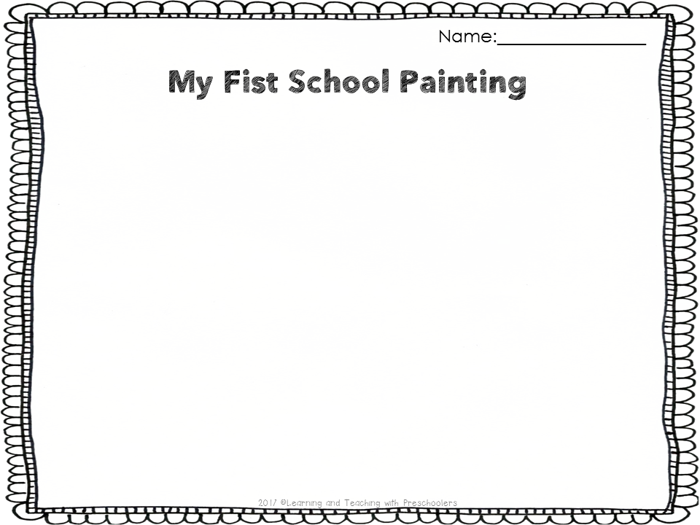
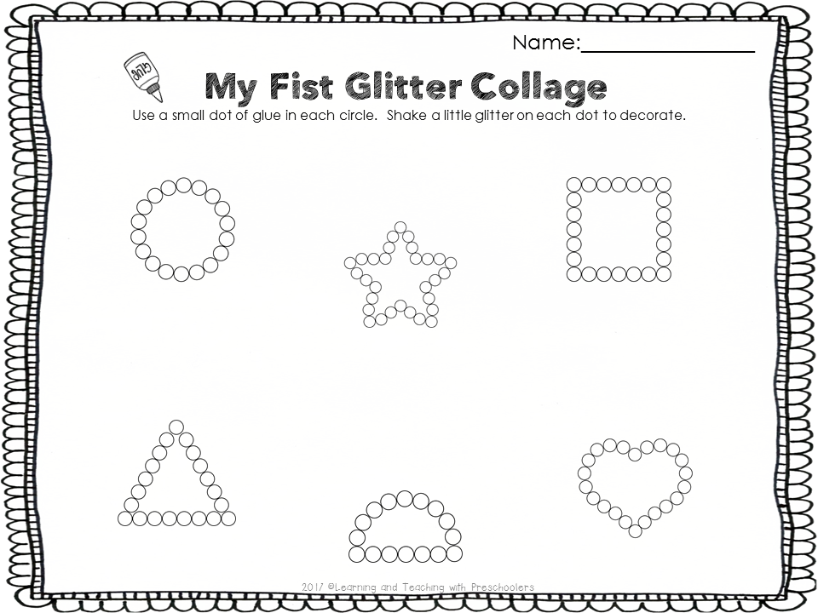
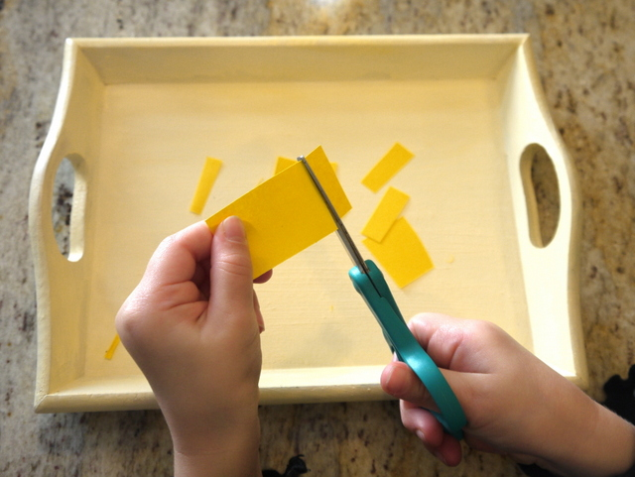
Monday | Tuesday | Wednesday
Small Group
Small Group
Small Group
Small Group
Small Group
 | How to Use Glue Gluing collage material
 | My First School Painting
 | How to Use the Glitter My First Glitter Collage
 | How to Use Scissors Cutting paper | How to Use Glue Paper Collage Use paper from cutting activity
My First School
Drawing
Blue
Yellow
Green
Rotate activities

Slide 7
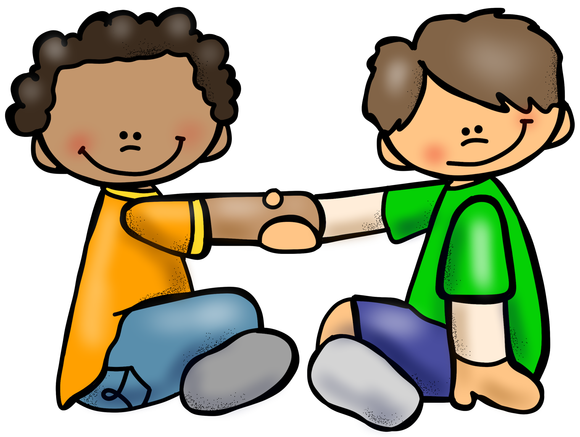
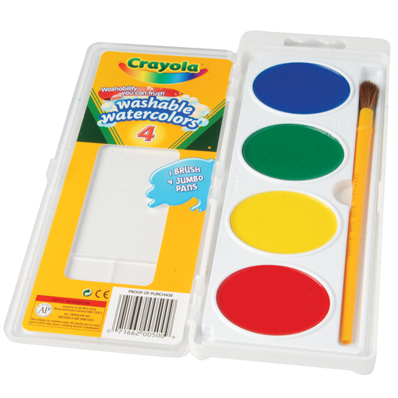
Thursday | Friday | Notes
Small Group
Small Group
Small Group
Small Group
Small Group
Pair & Share
Turn to neighbor Hi my name is __________. What is yours?
My First School Painting

