Slide 1
Circle Time Routines
First Circle Social/Social Studies/Math | Second Circle ABC Circle/Science
Morning Song Greeting our Friends Social Lesson Song Morning Message (Math) Math Lesson Transition to Wash hands for Breakfast | Movement Song ABC Song Language/Lit Lesson Morning Message (ABC) Book Reading Transition Game to Wash hands for Snack

Slide 2
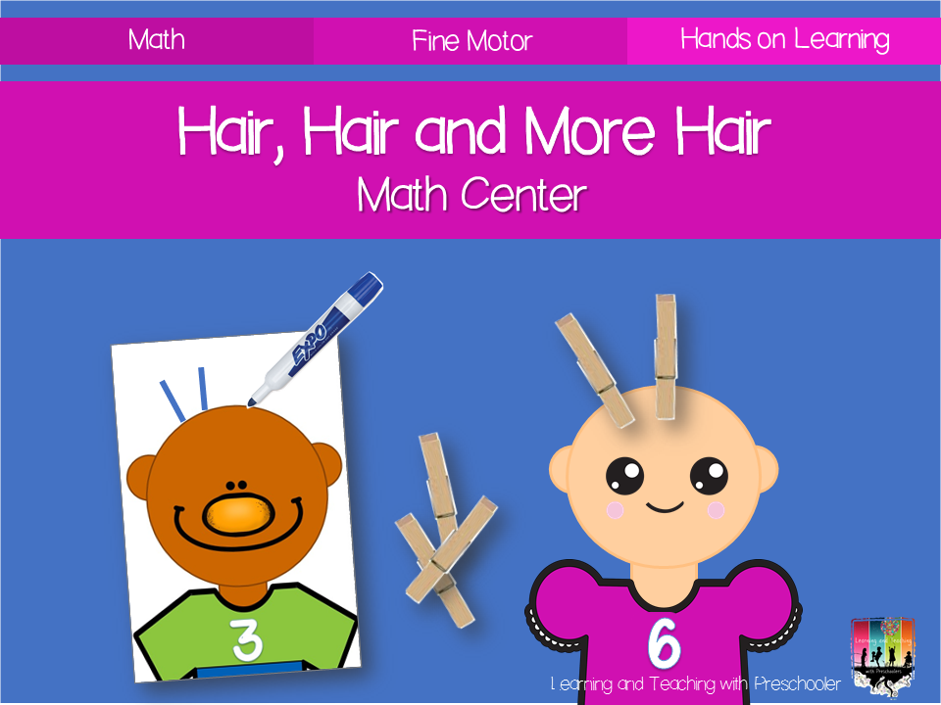
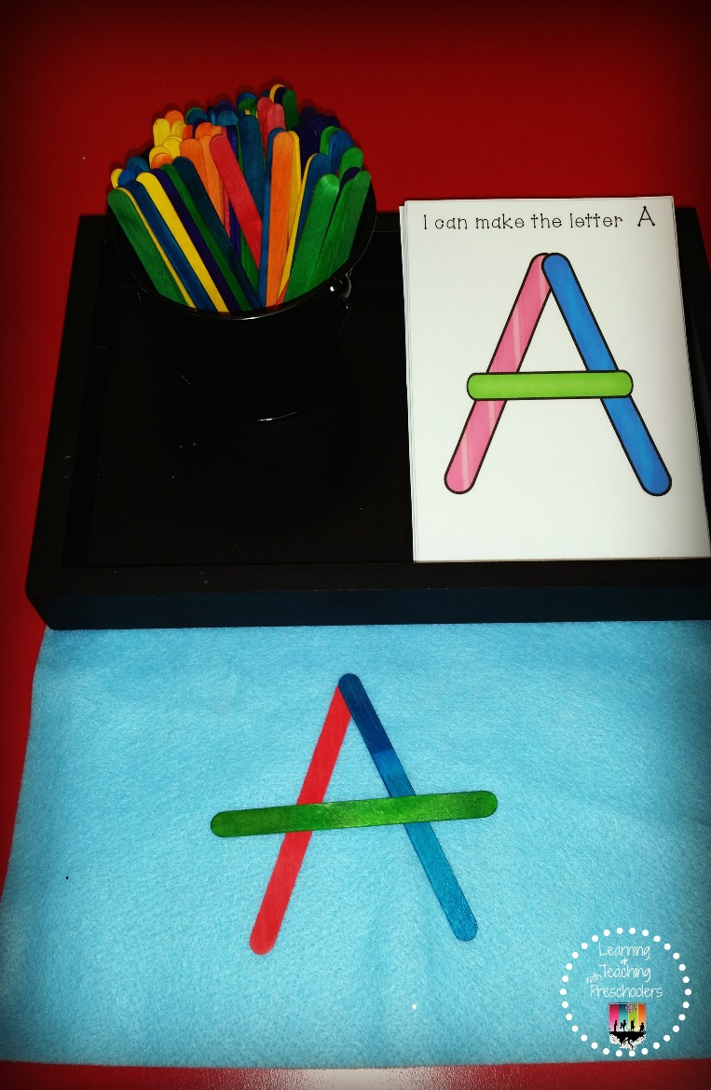
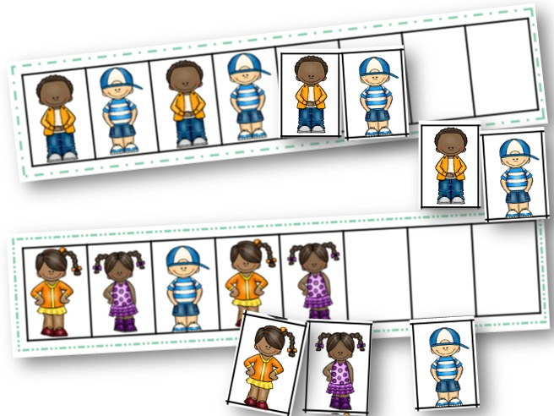
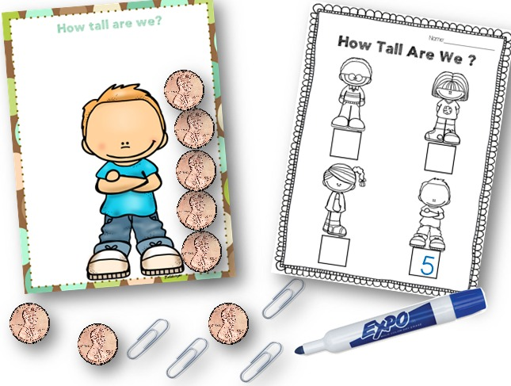
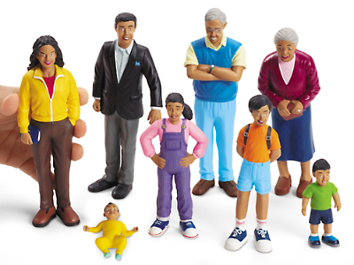
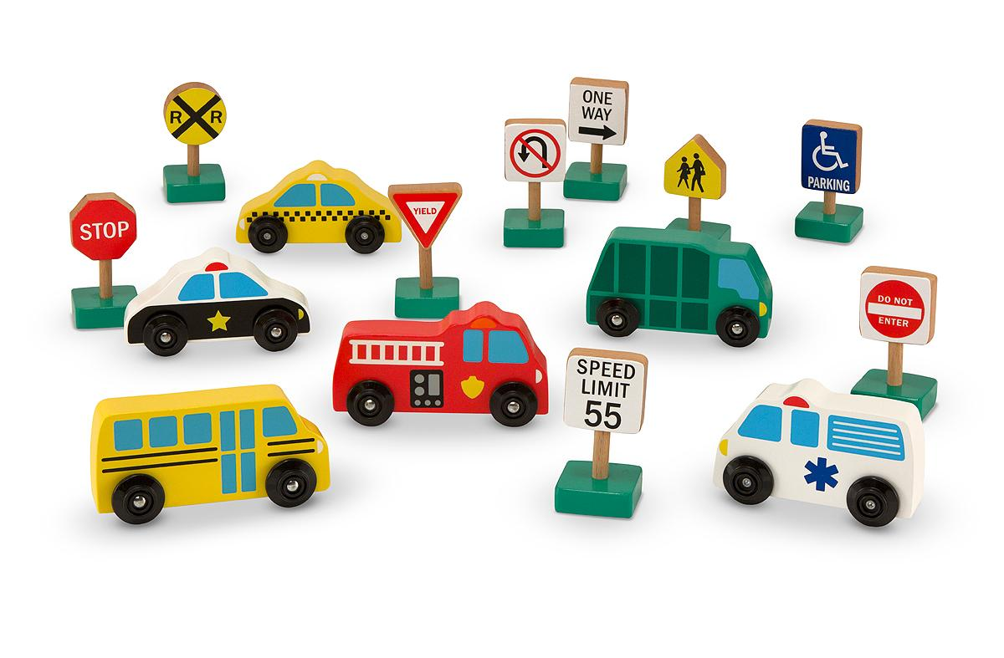
Changing
the
July
Theme: _____________________
Writing Center
Math Center
Introduce Stick Letter Cards
Introduce how to use math clipping cards.
Add Pattering Activity & Measurement Activity
Block Center
Dramatic Play
Introduce roles that can be played in the dramatic play center. (Mommy, Daddy, Baby, Sister, Brother and Grandparents)
Use role necklaces for each role available
Introduce people and vehicles.
How to put them away
Introduce ways to take turns.

Slide 3
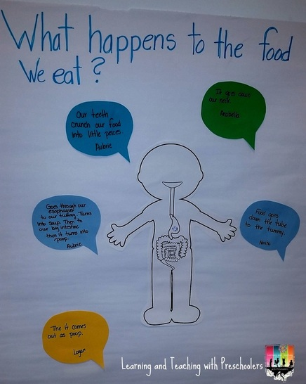
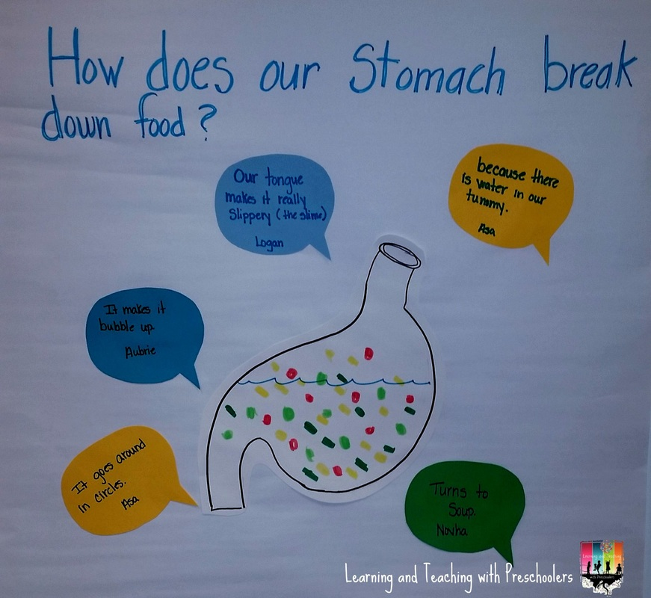
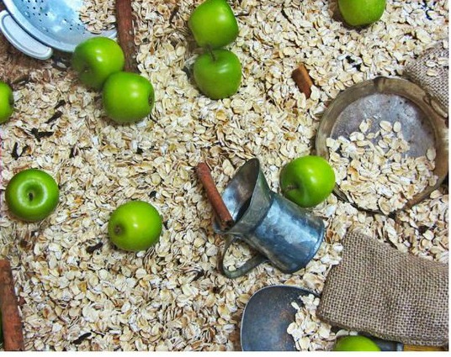
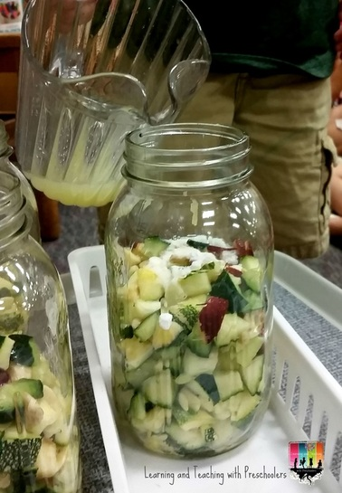
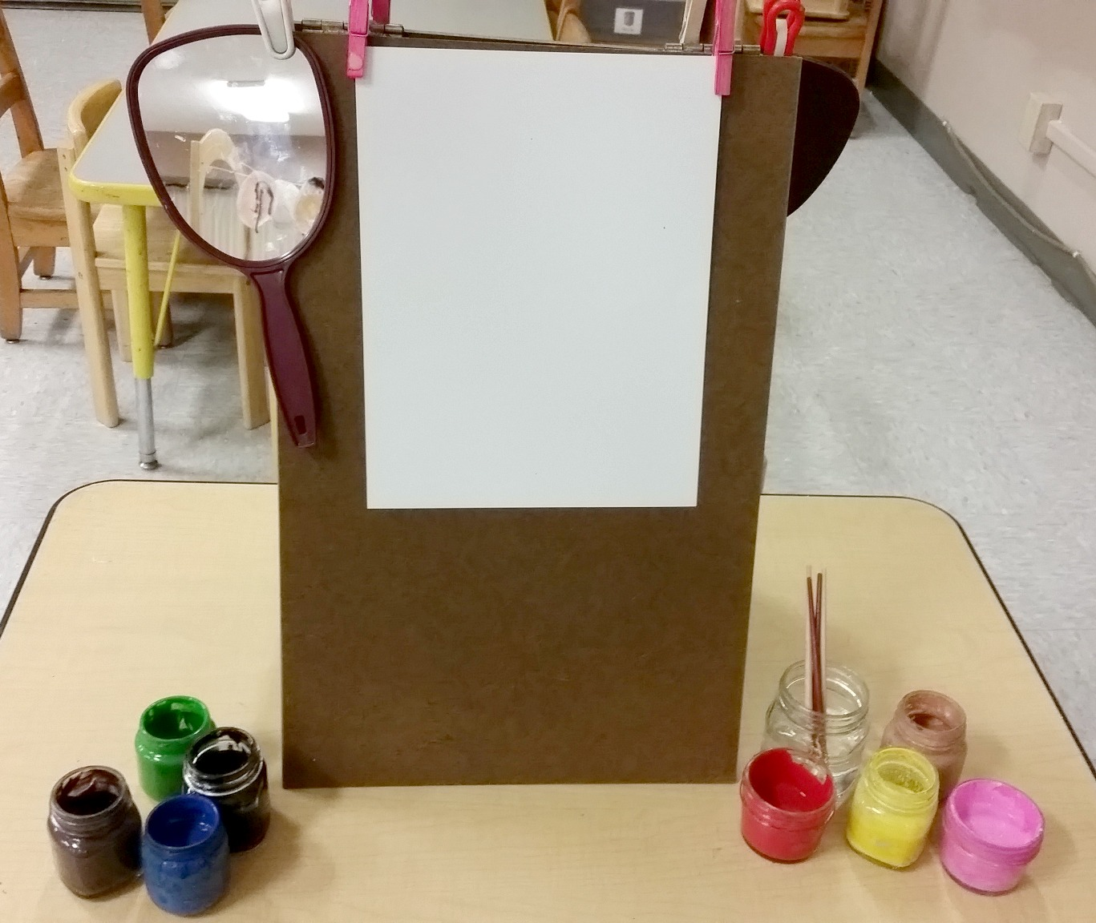
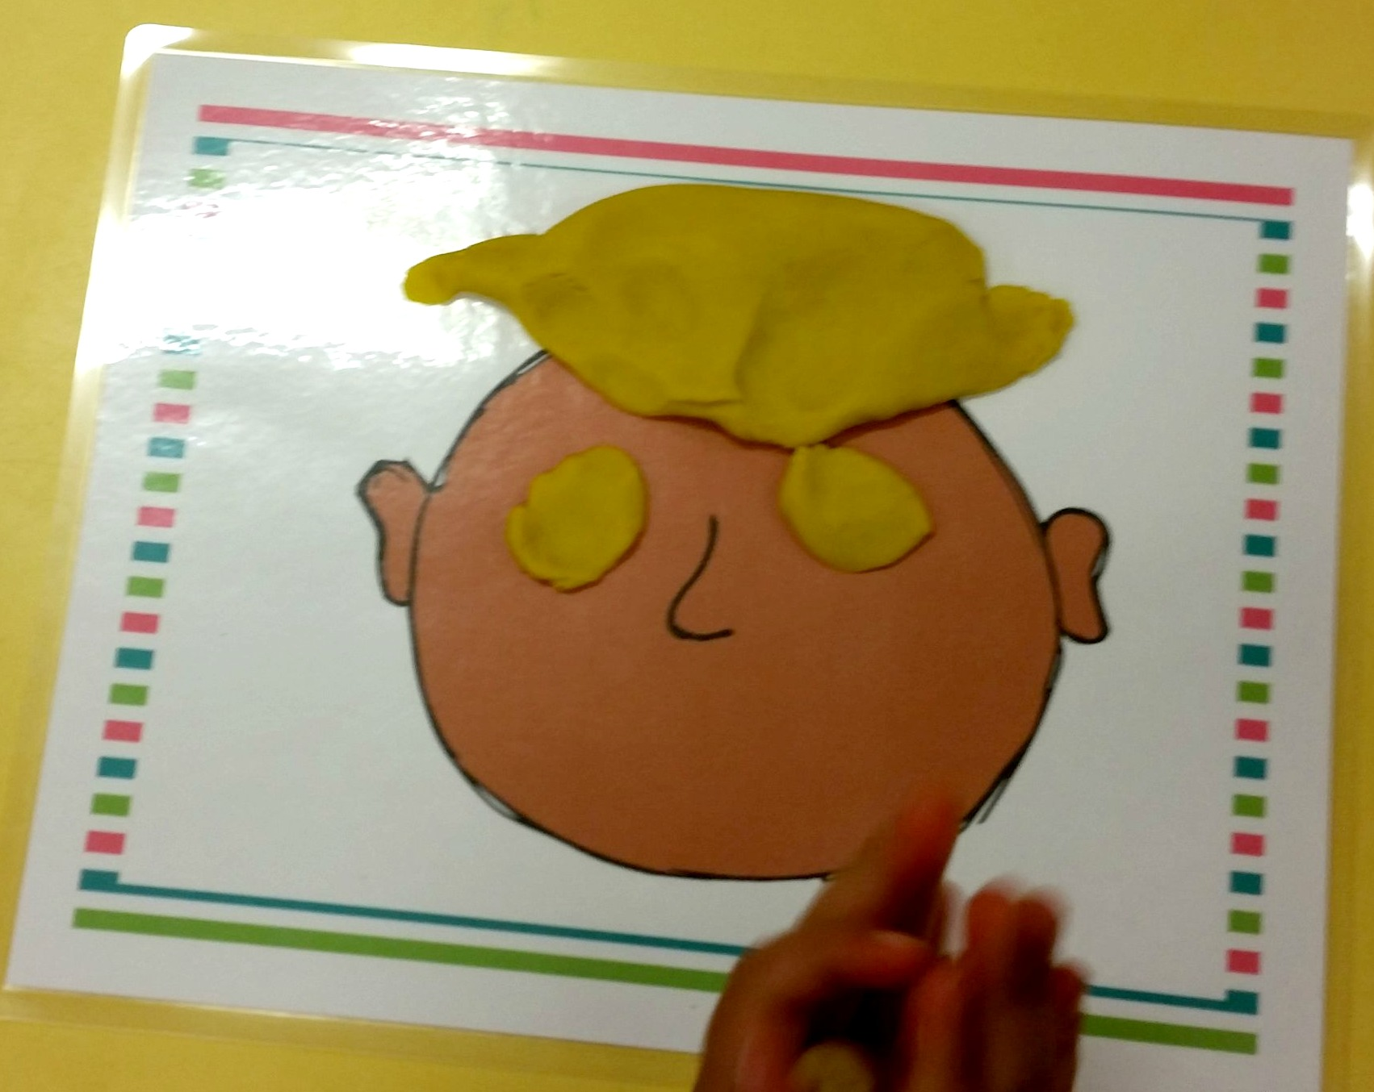
Keeping them engaged
Centers
Date: _____________________
Science Center
Sensory Table
Apple Sensory Bin
Add oats, cinnamon sticks, mini apples, tongs, bowls and scoops
Play Dough
Art Center
Add mirror to easel so children can paint a
self-portrait
^Learning and Teaching with Preschoolers

Slide 4
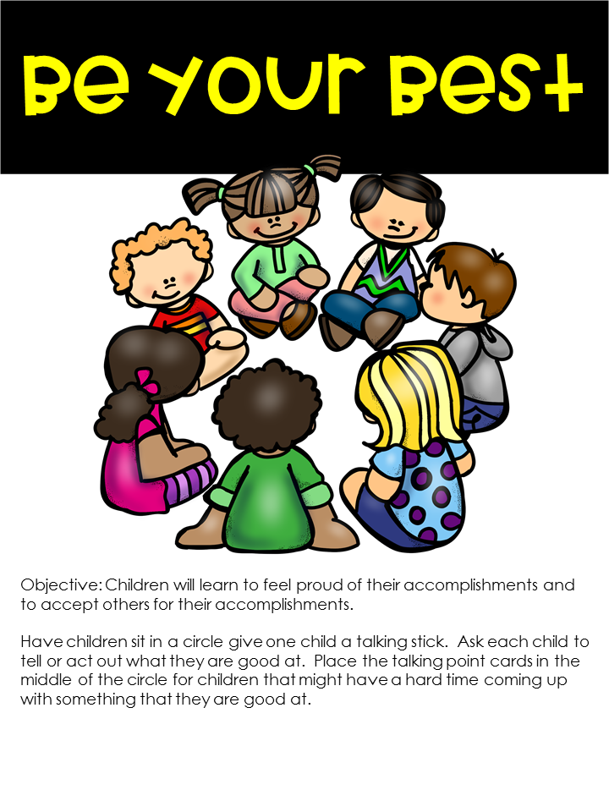
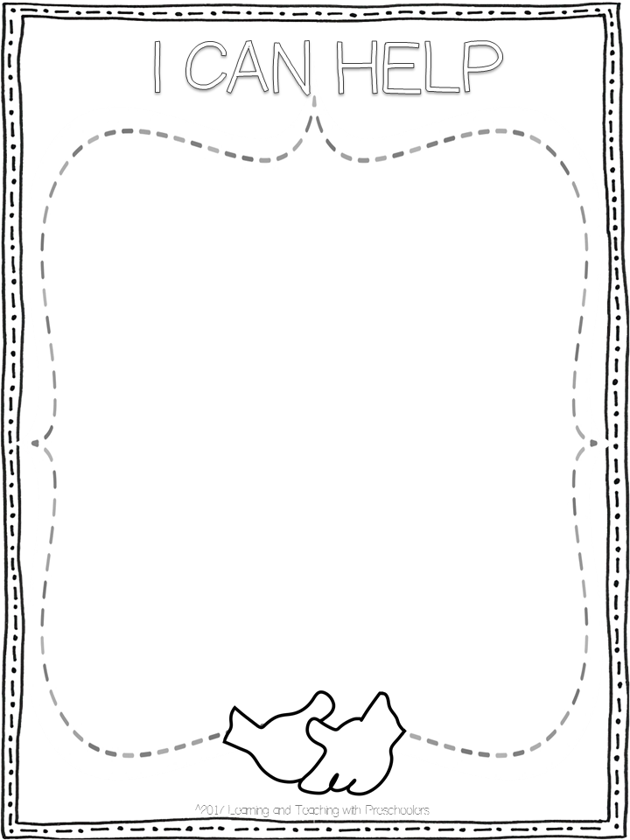
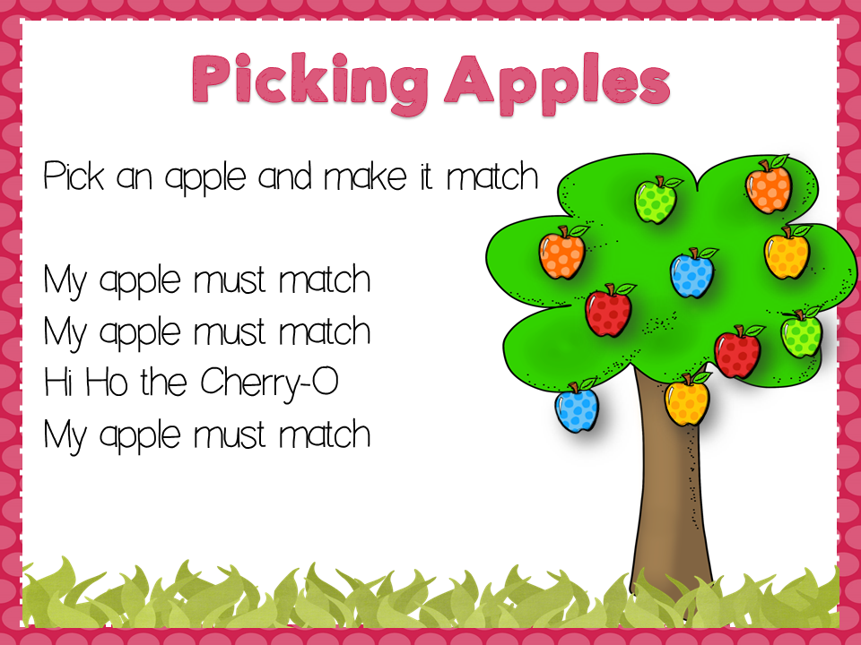
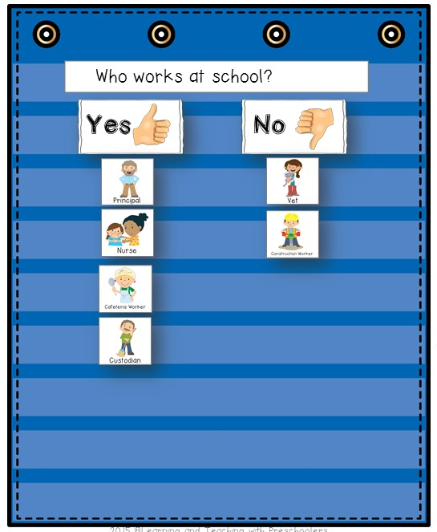
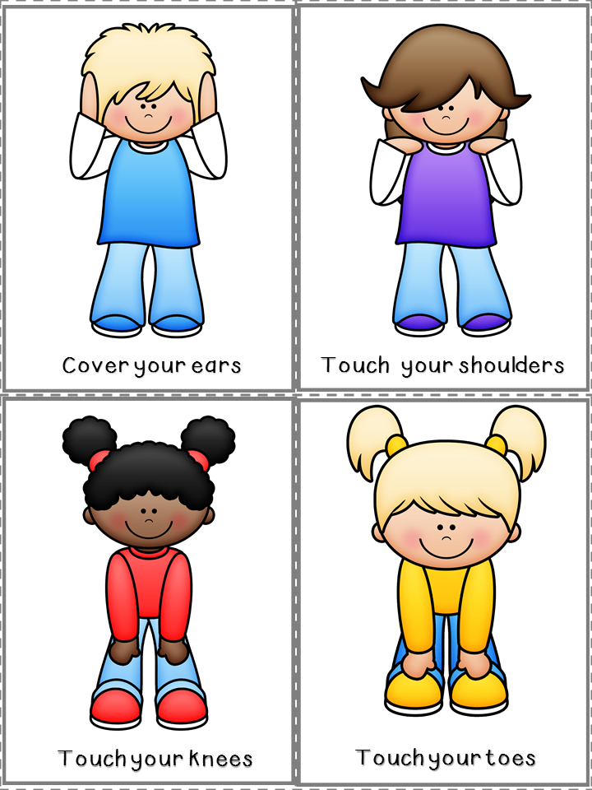
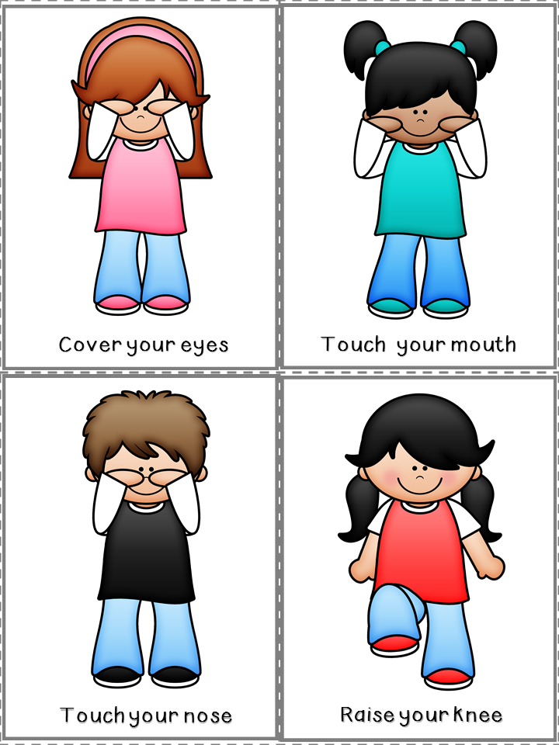
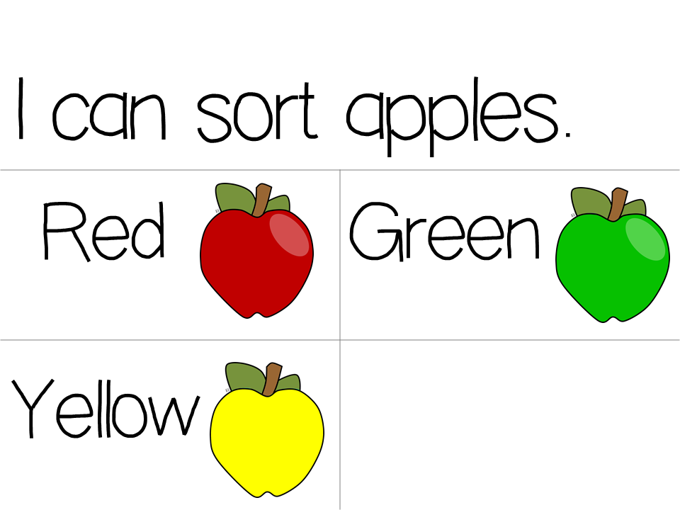
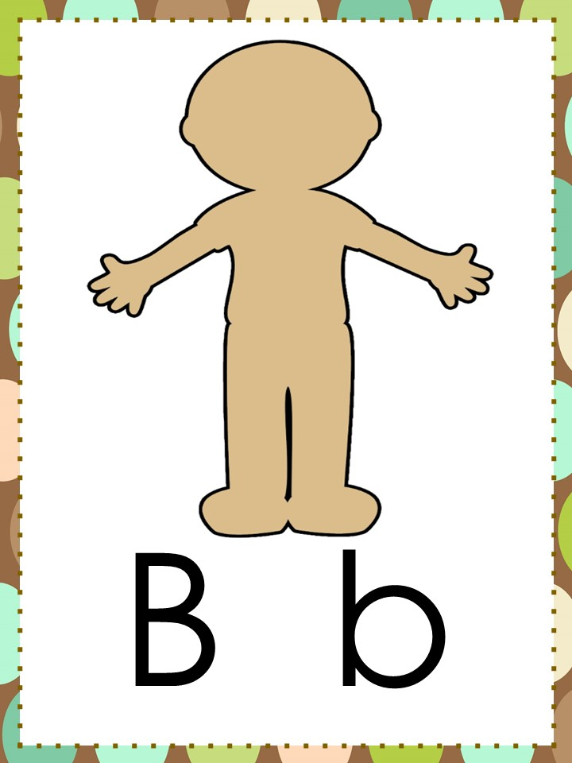
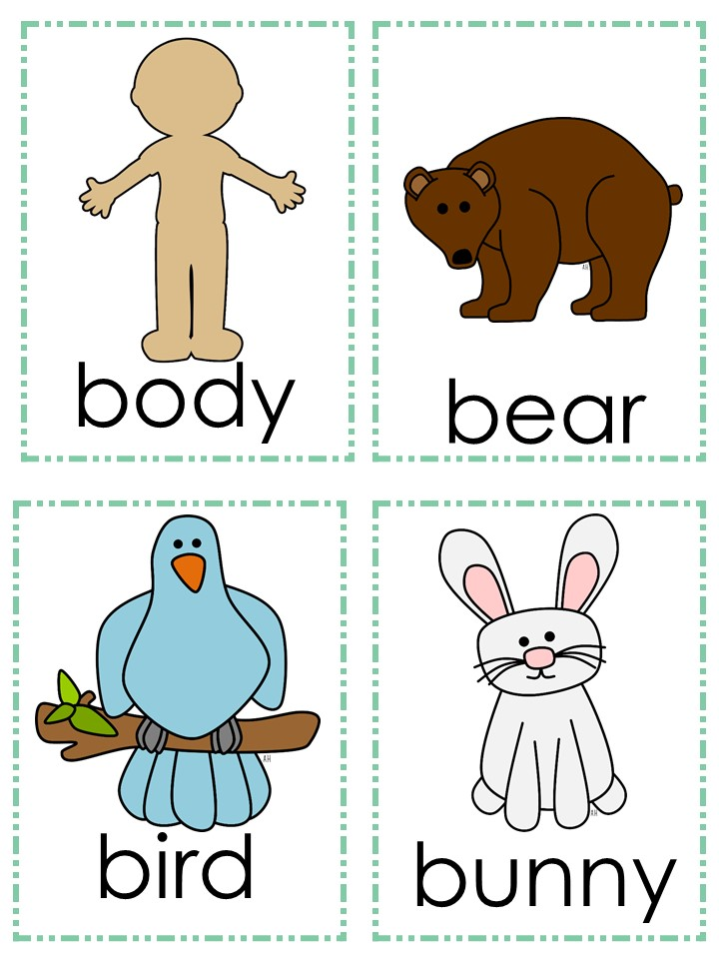
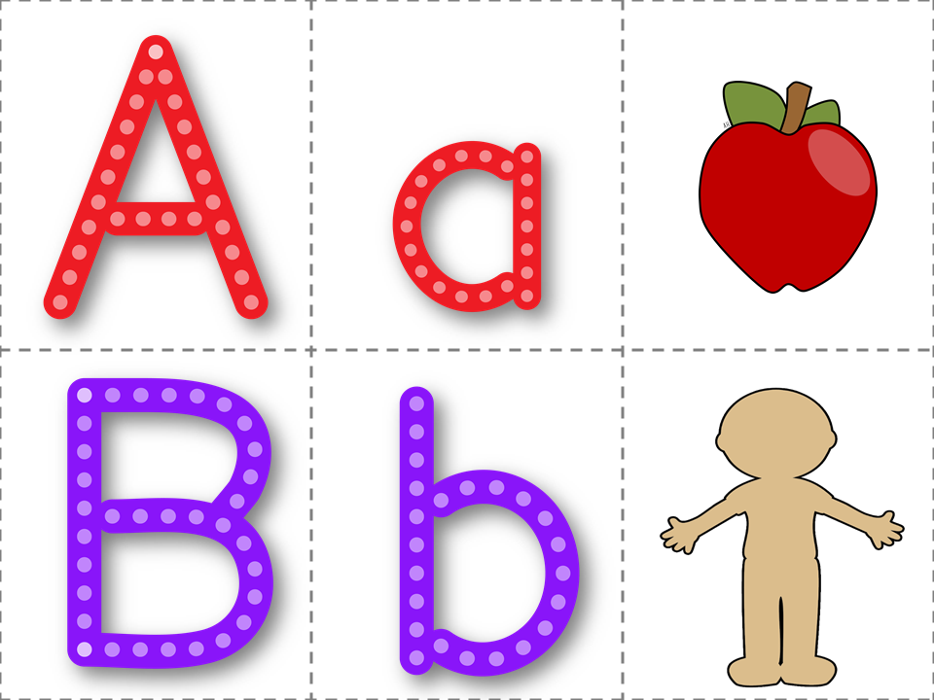
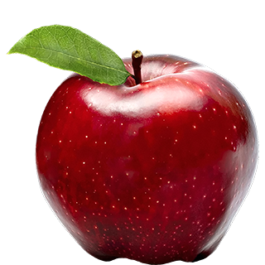
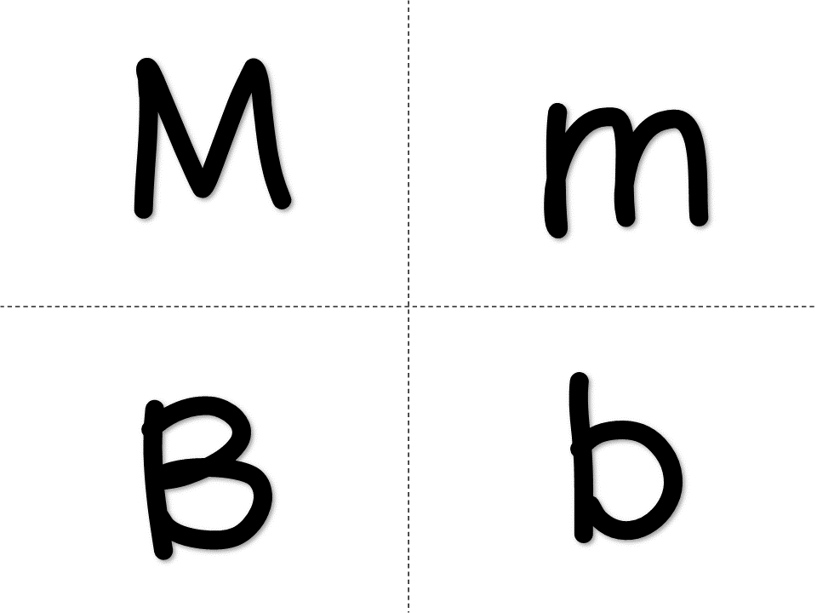
Theme:____________
Monday | Tuesday | Wednesday
Social /Social Studies /Math Circle
ABC Circle/Science
Social Skills Caring for Ourselves Be proud of what your good at. Math Patterns & Algebra visually discriminate Transition: Strick a Pose Movement Cards | Social Science Read: Have You Filled A Bucket Today? Math Geometry: describe positions in and out. Transition: I can sort apples | Social Skills I Can Help… Ways to help others Social Study Who Works at School Pocket Chart Sort Transition: Strick a Pose Movement Cards
ABC Alphabet Recognition: Sing ABC Song with Cards Introduce the Letter Bb Read: Transition: Butcher Paper Writing Write the letter Mm | Science What’s does an apple look like? What’s inside? Transition: Throw out the Trash M and B | ABC Print Awareness Distinguish Print from Pictures Transition: Butcher Paper Writing Write the letter Bb

Slide 5
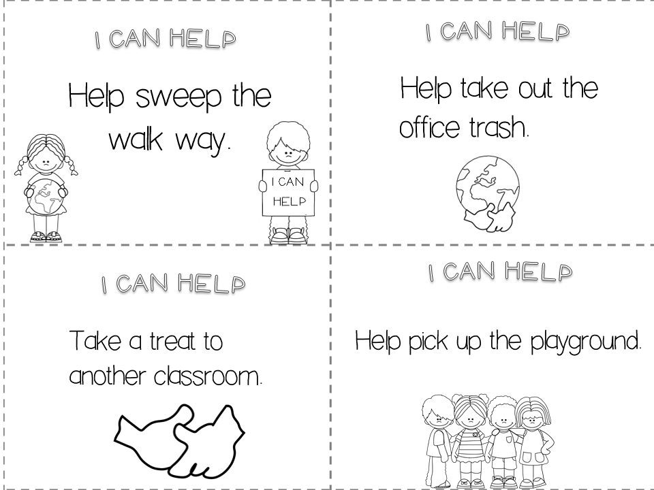
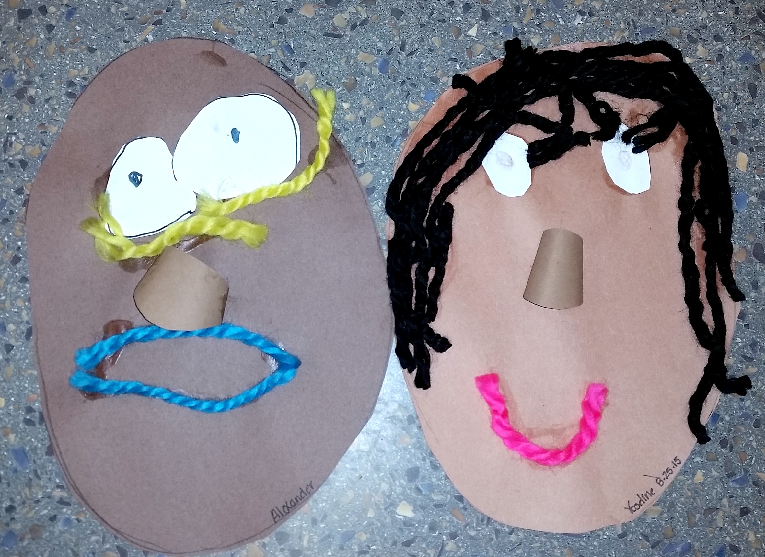
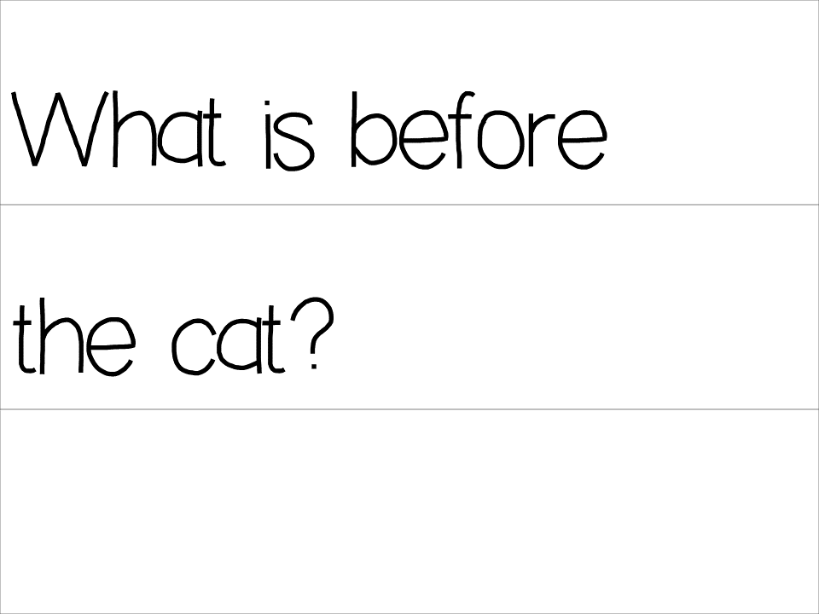
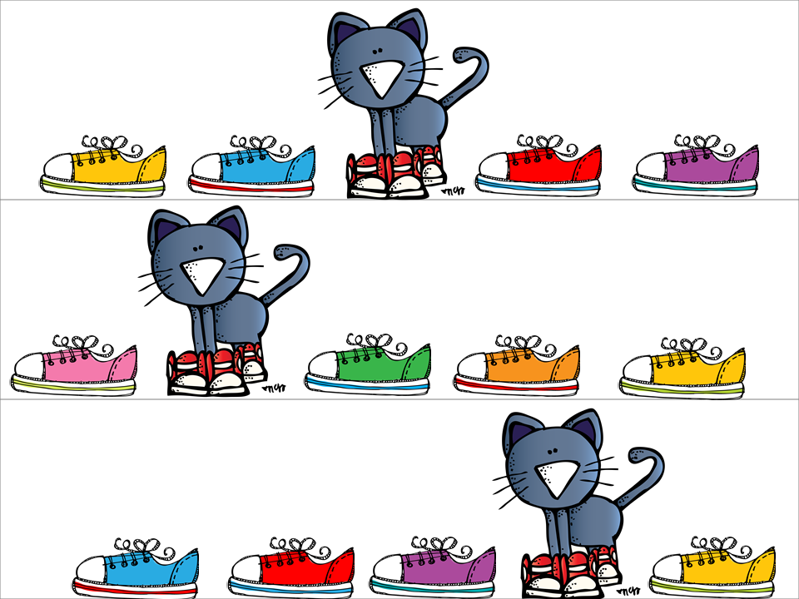
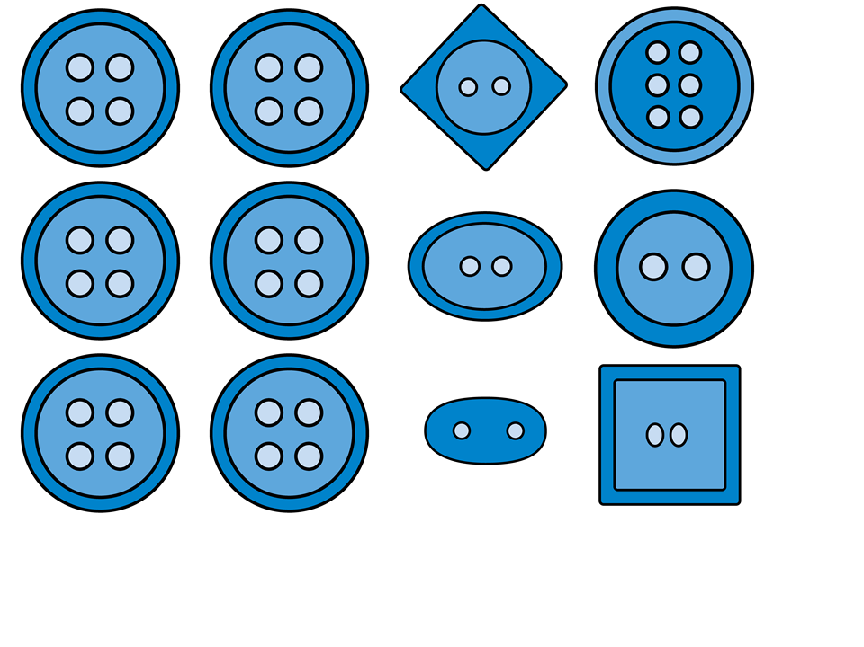
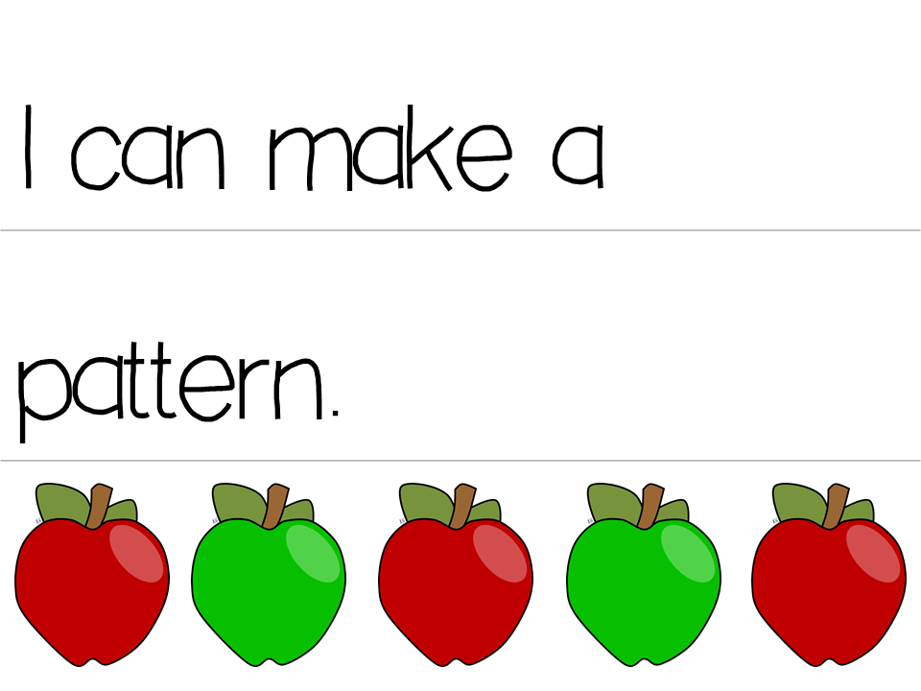
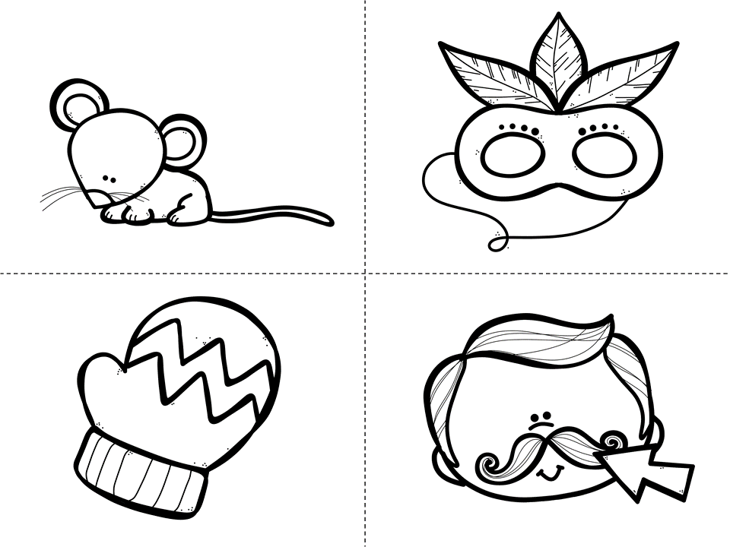
Thursday | Friday | Worktime
Social /Social Studies /Math Circle
ABC Circle/Science
Social Skills I Can Help Pick a card and go out as a group to complete it together. Math Patterns & Algebra: visually discriminate Transition: I can make a pattern | Social Skills Math Transition: Strick a Pose Movement Cards | Self Portraits Process art who we are Set out collage materials that can be used to create faces with.
ABC Sing ABC Song with Cards Read: If your Happy and You Know It Transition: Throw out the Trash Beginning Sounds M and B | Shared Writing Sentence Frame Make a list of Make a list: Favorite Food Transition: I can write the letter in my name. Large sheet of paper for children to write on.
Geometry:
describe positions before and after

Slide 6
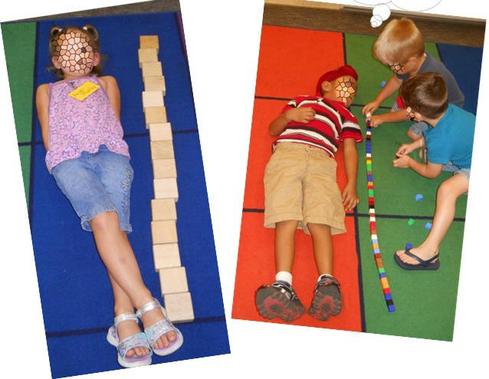
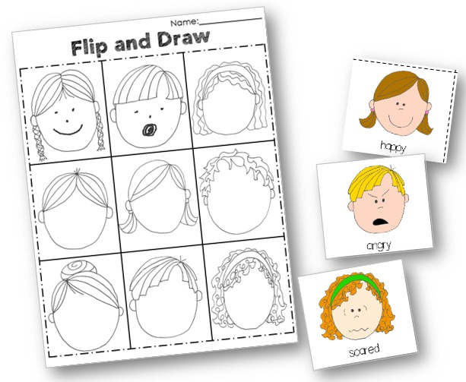
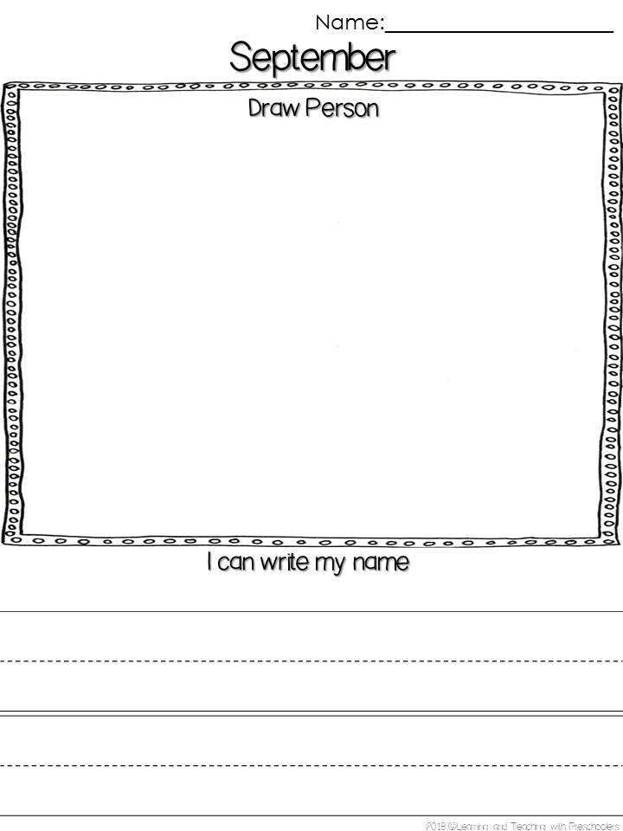
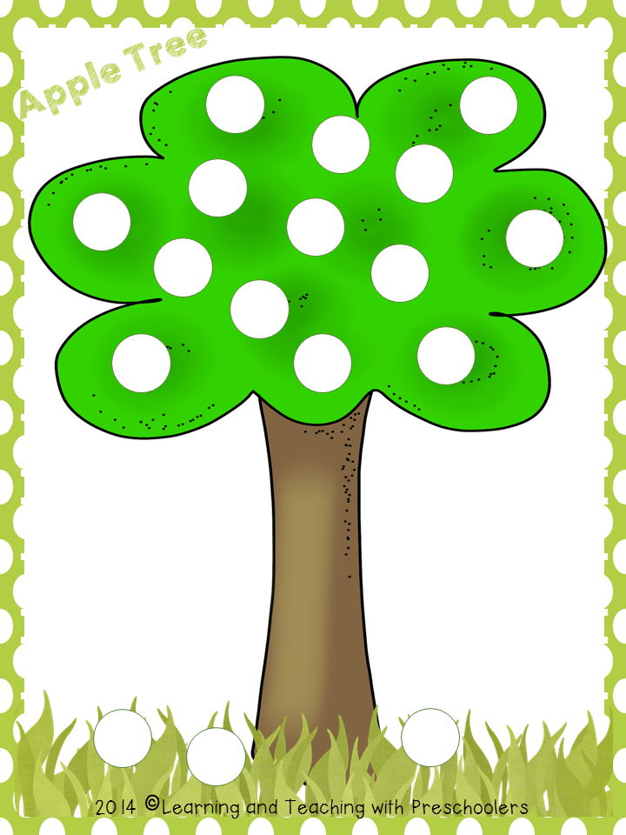
Monday | Tuesday | Wednesday
Small Group
Small Group
Small Group
Small Group
Small Group
 | How many Tall Measurement Assessment
 | Flip and Draw Emotions Assessment Number Recognition (1-6)
 | Pinch and Cover Building Fine Motor Skills
Name Writing
Or
Name Building
Blue
Yellow
Green
Rotate activities
Holiday
Draw Person & Name Writing Assessment
Draw Person & Name Writing Assessment

Slide 7
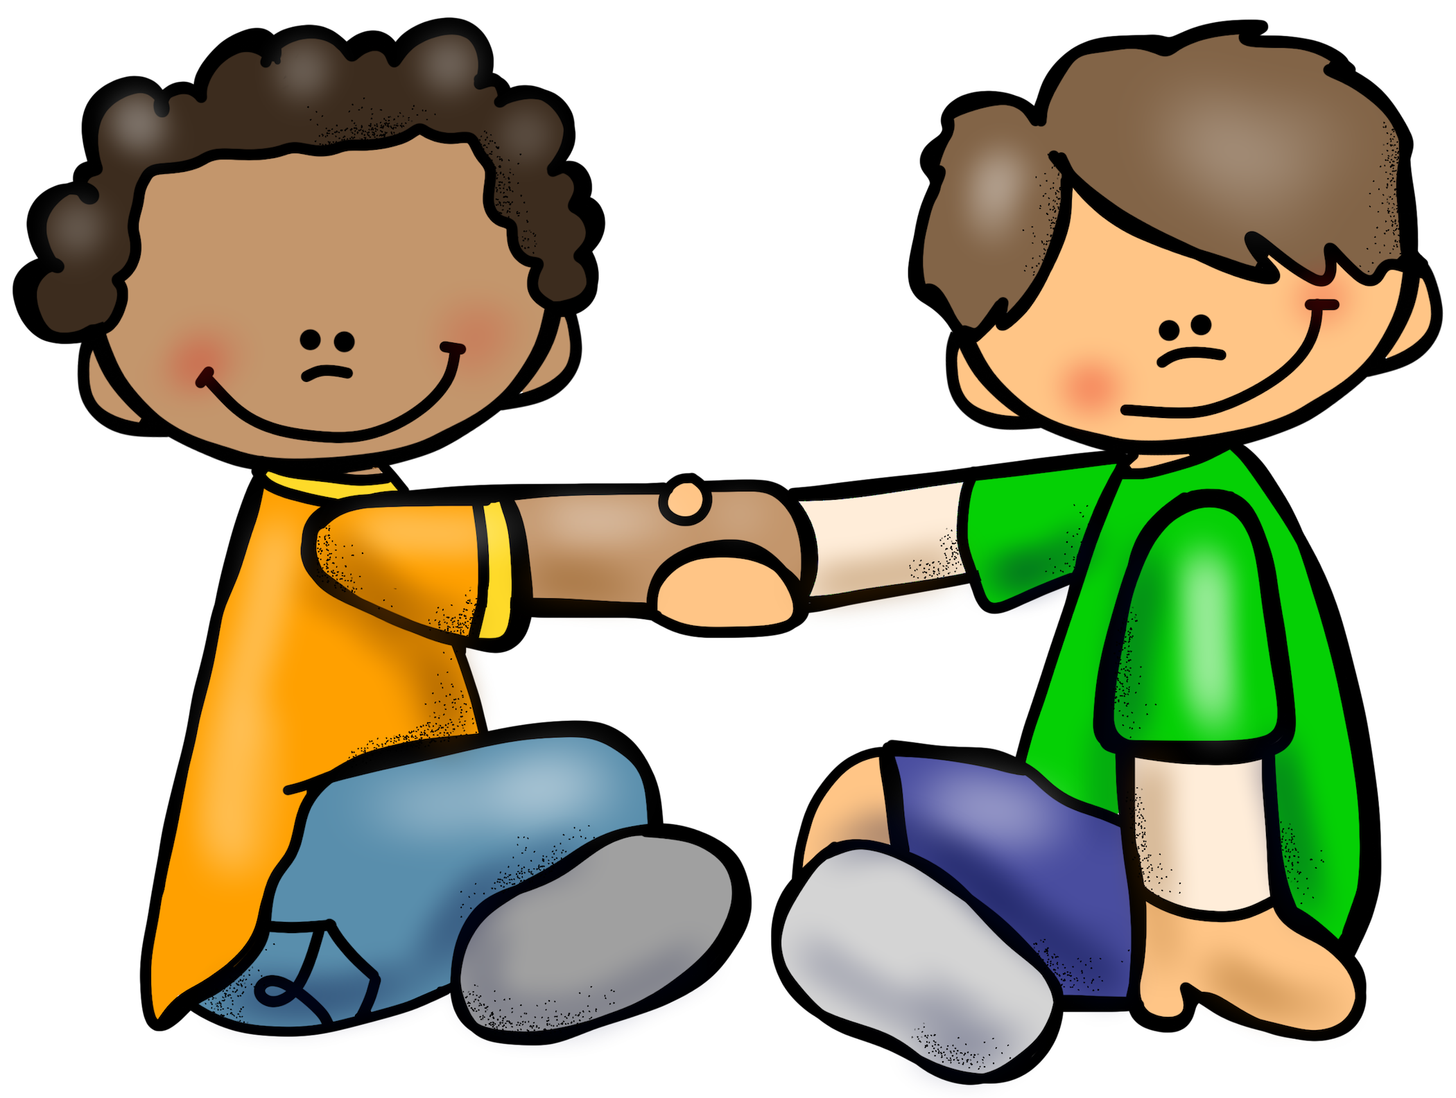
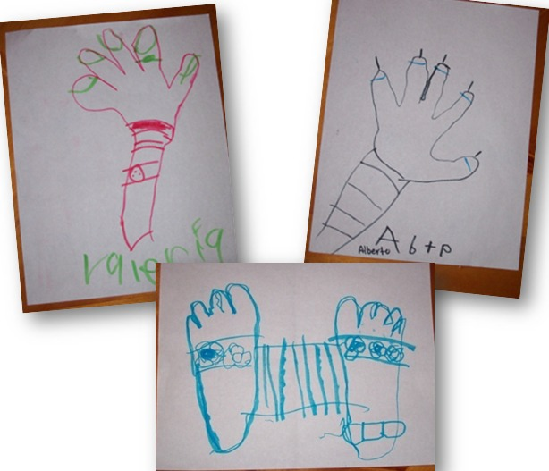
Thursday | Friday | Notes
Small Group
Small Group
Small Group
Small Group
Small Group
How Many Tall Body Part Tracing
How Many Tall Assessment Measurement
Pair & Share
Turn to neighbor I like to help with _____________.

