Slide 1
Circle Time Routines
First Circle Social/Social Studies/Math | Second Circle ABC Circle/Science
Morning Song Greeting our Friends Social Lesson Song Morning Message (Math) Math Lesson Transition to Wash hands for Breakfast | Movement Song ABC Song Language/Lit Lesson Morning Message (ABC) Book Reading Transition Game to Wash hands for Snack

Slide 2
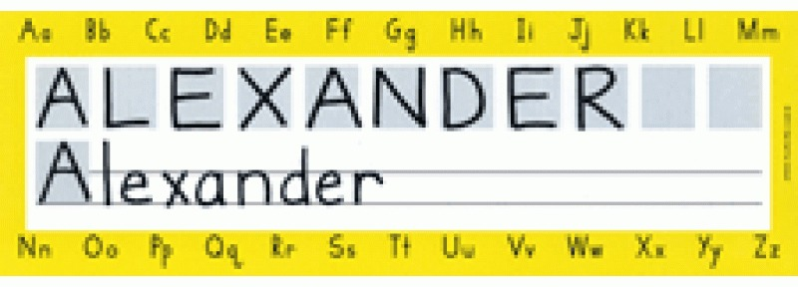
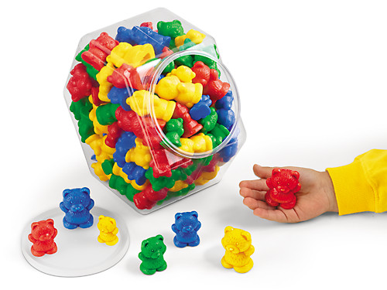
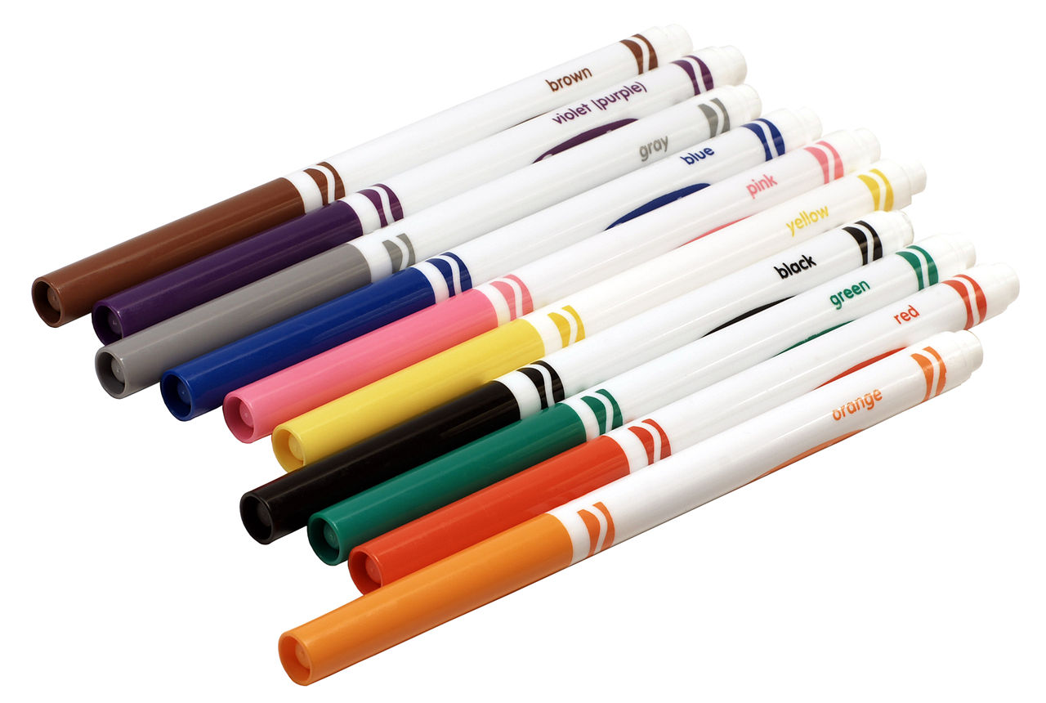
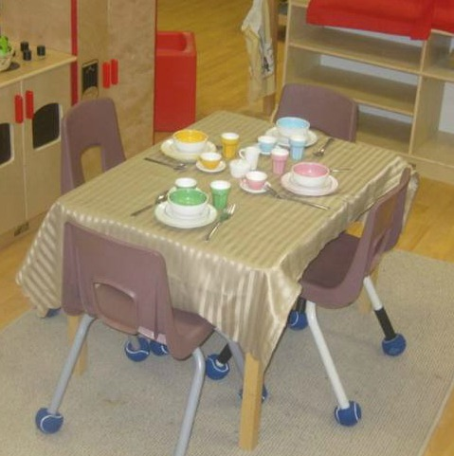
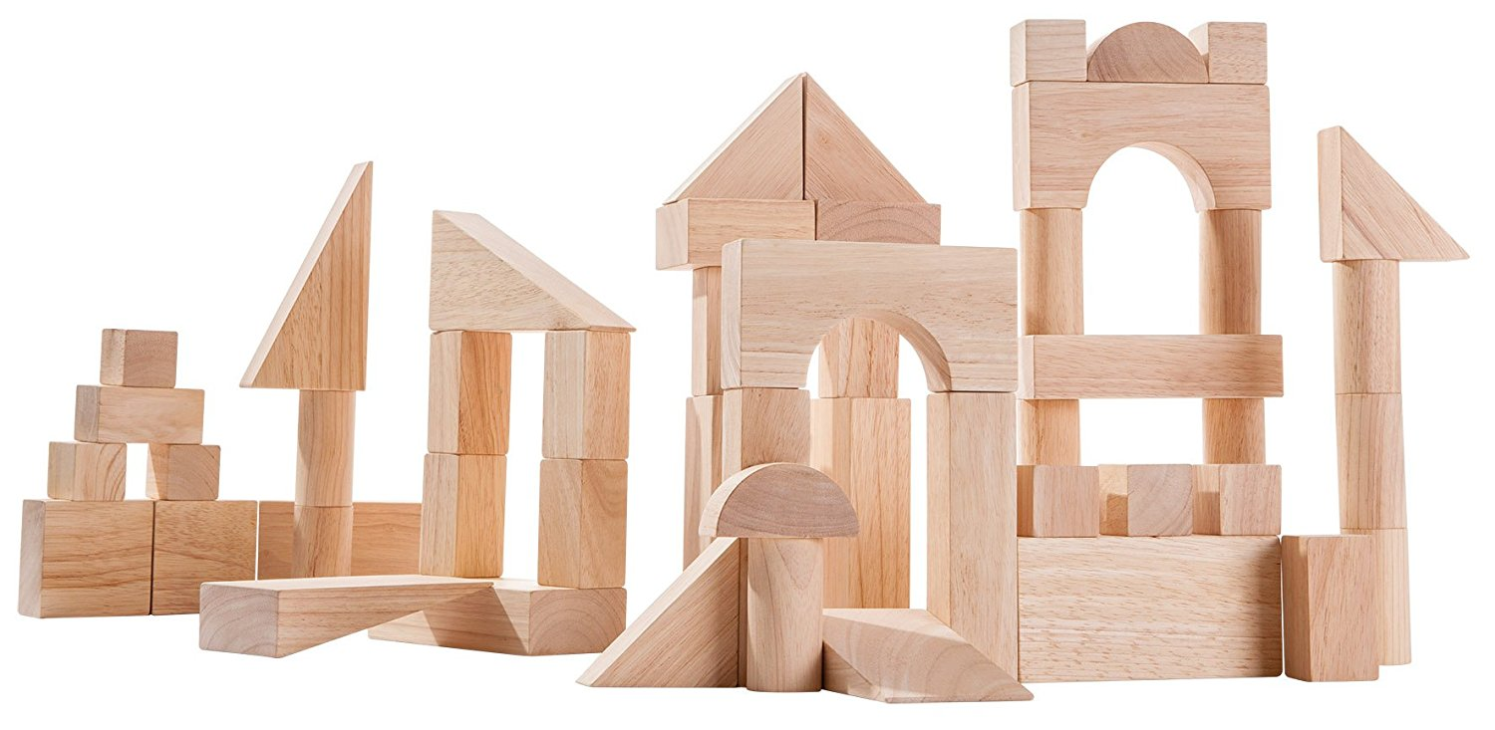
Changing
the
July
Theme: _____________________
Writing Center
Math Center
Introduce Name Plates
Introduce how to use
Markers
Introduce how to use math counters.
How to put counters away
Block Center
Dramatic Play
Introduce how to set the table.
Introduce how to use wooden blocks.
How to put blocks away
Introduce how to put all the items away.

Slide 3
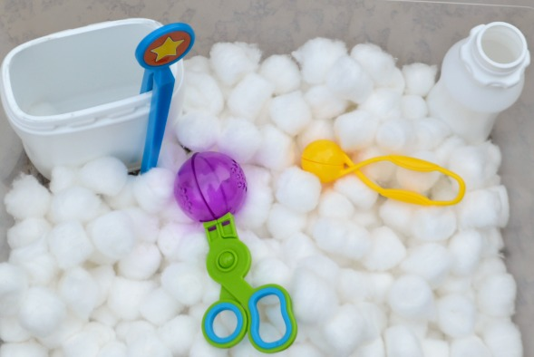
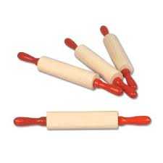
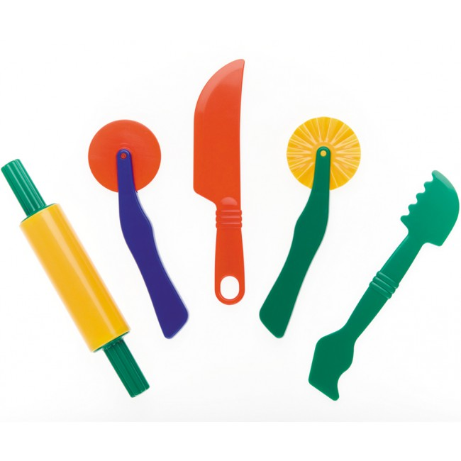
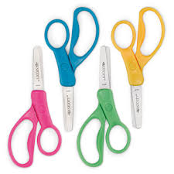
Keeping them engaged
Centers
Date: _____________________
Science Center
Sensory Table
Introduce how to use the sensory table.
Closed
Cotton ball Scoop and Pinch
Play Dough
Art Center
Introduce how to use play dough rollers and cutters.
Introduce how to use scissors with paper strips
How to put materials away
^Learning and Teaching with Preschoolers

Slide 4
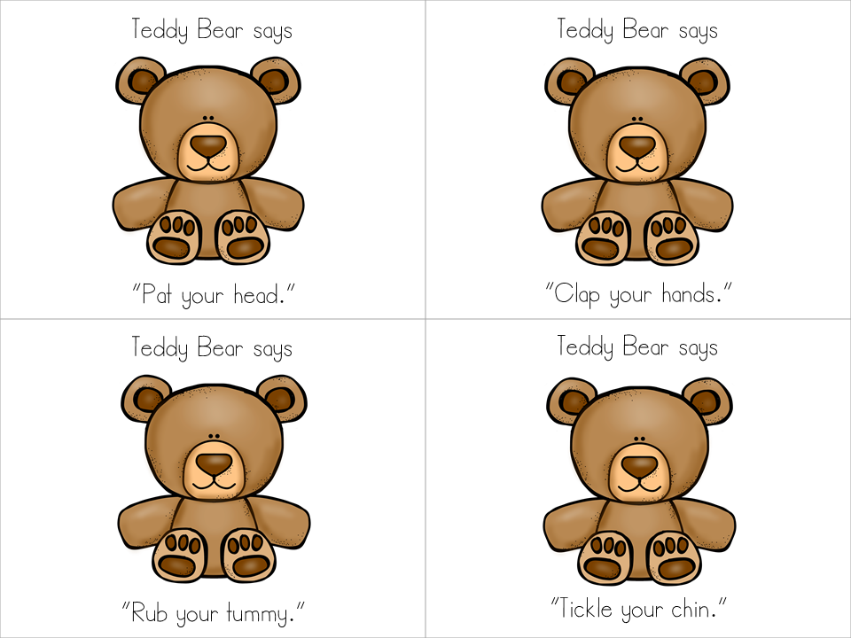
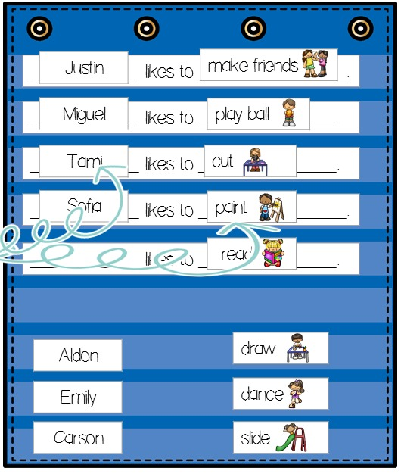
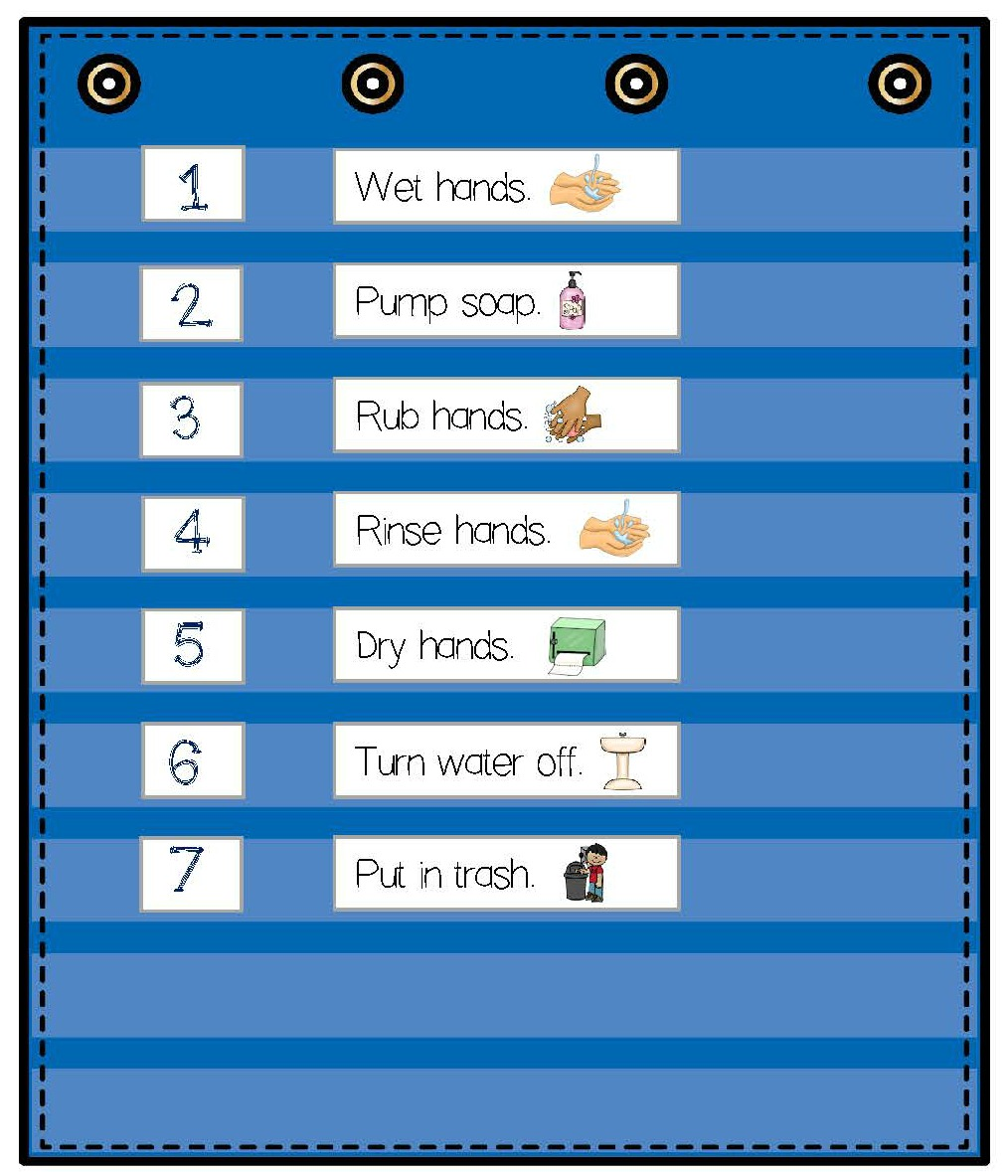
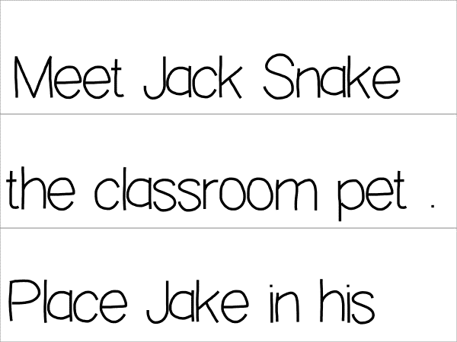
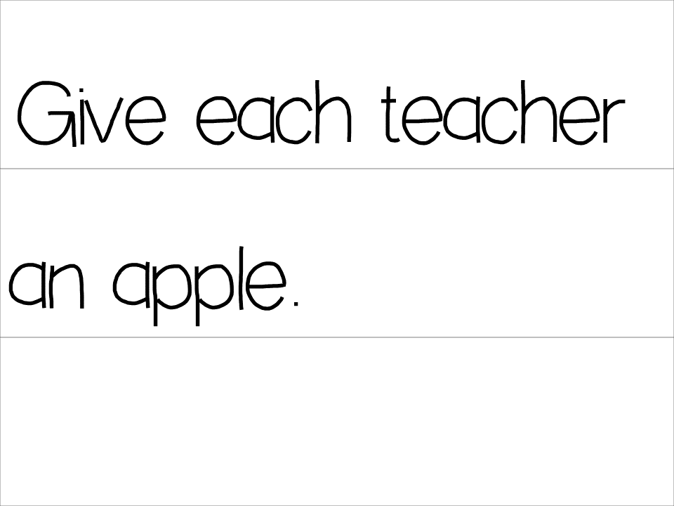
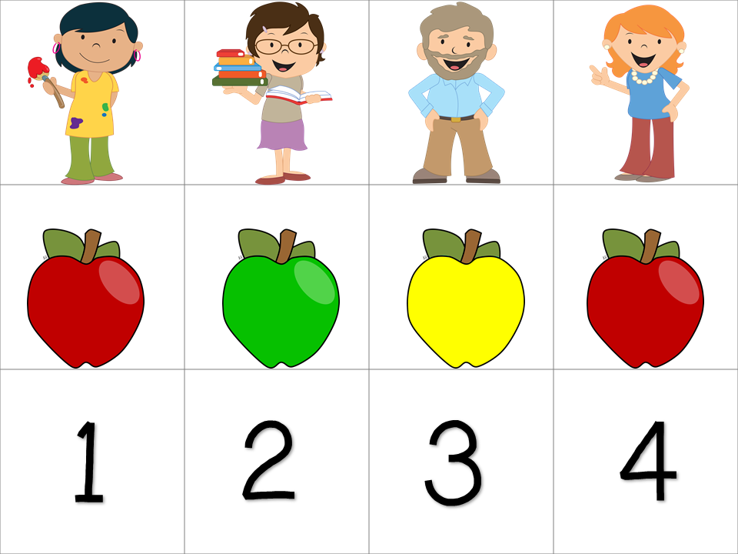
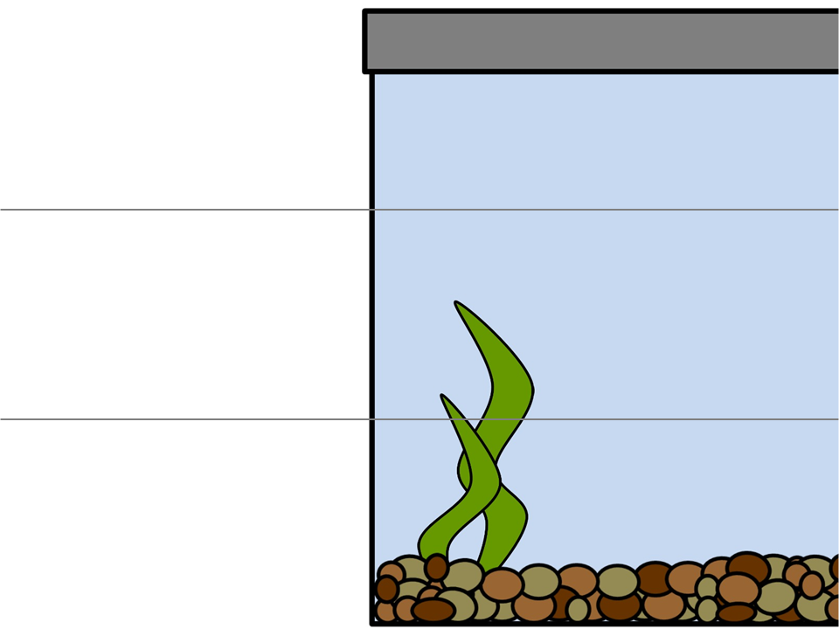
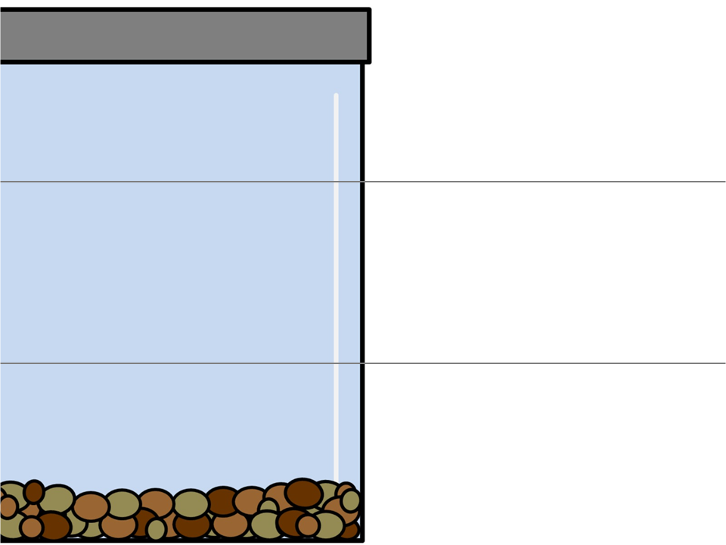
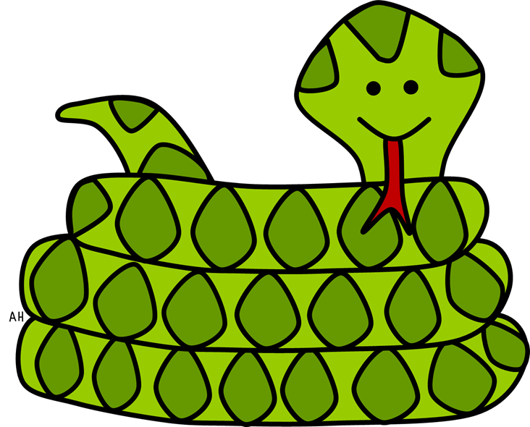
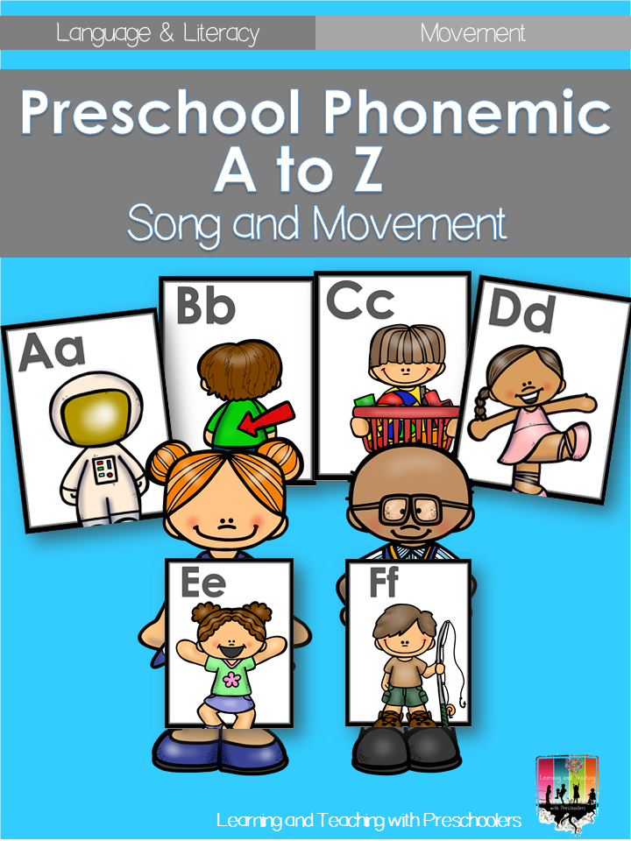
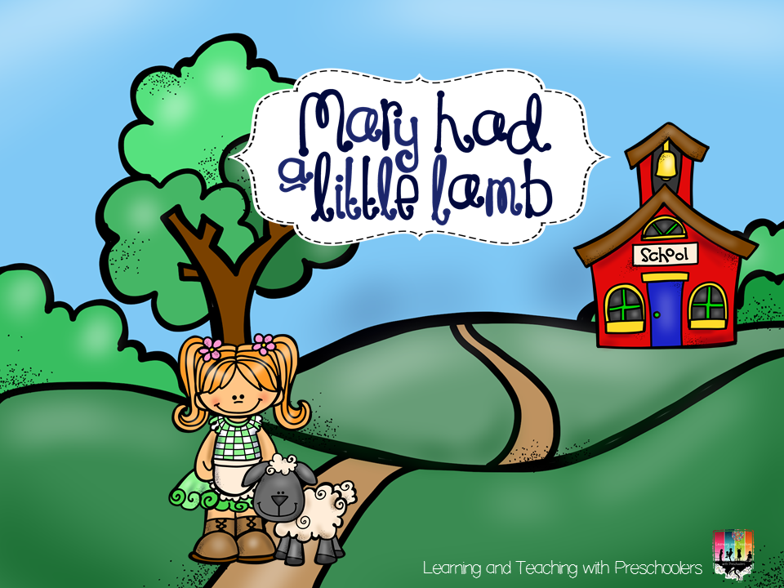
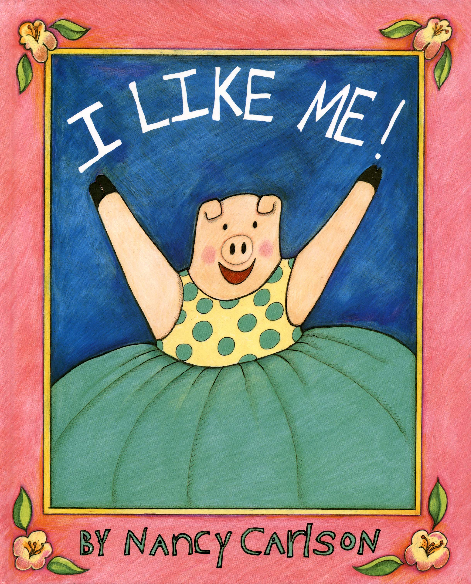
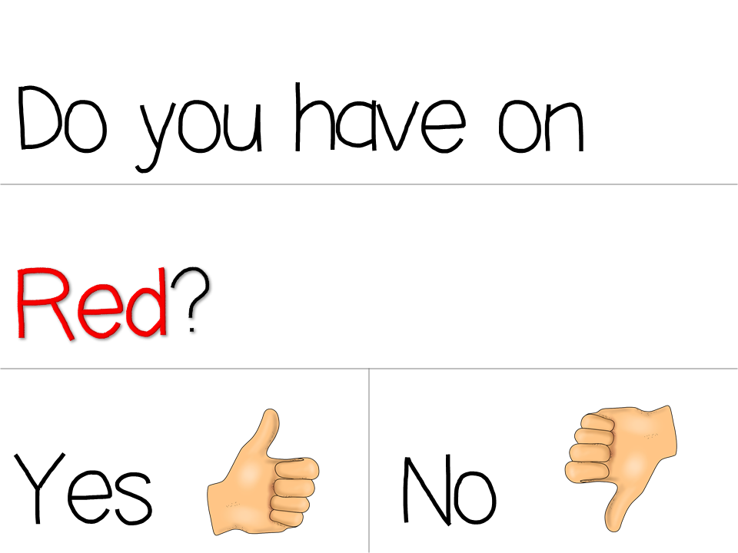
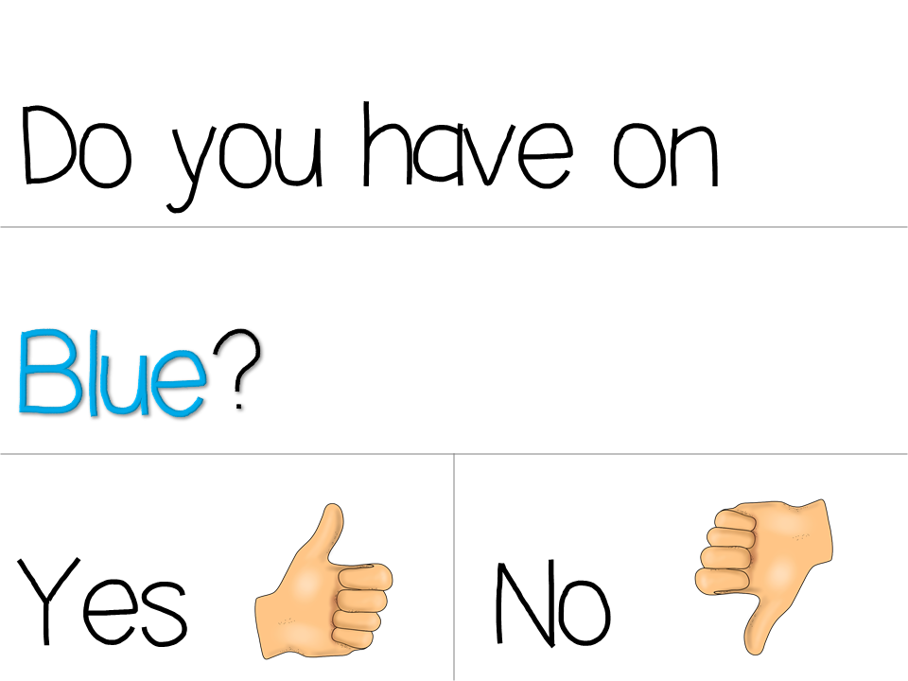
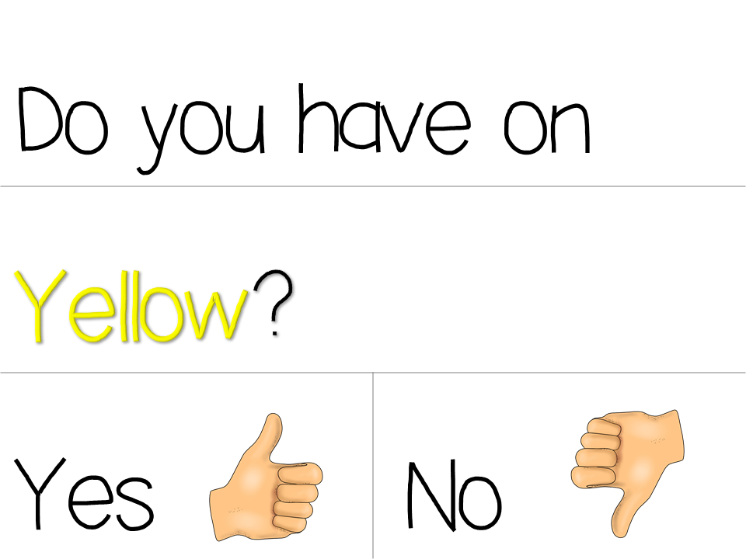
Theme:____________
Monday | Tuesday | Wednesday
Social /Social Studies /Math Circle
ABC Circle/Science
Social Skills Read: At School Pocket Chart Math Number Sense: One to One Correspondence Transition: Catching a Ball | Social Science I can listen Review hand washing with pocket chart story Math Geometry: In and Out Transition: Block Balance Beam | Social Skills I can listen Play Teddy Bear Game Social Study Read: Our School Transition: Catching a Ball
ABC Sing ABC Song with Cards Read: I Like Me Transition: Daily Question | Science The Human Body Transition: ‘Daily Question | ABC Sing ABC Song Mary Had a Little Lamb Transition: Daily Question

Slide 5
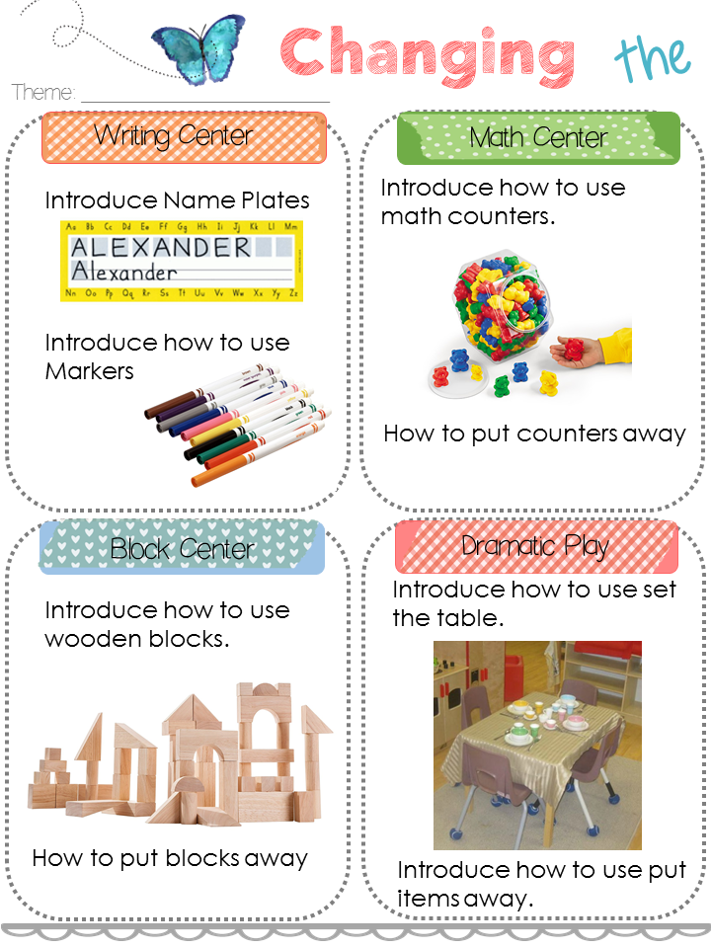
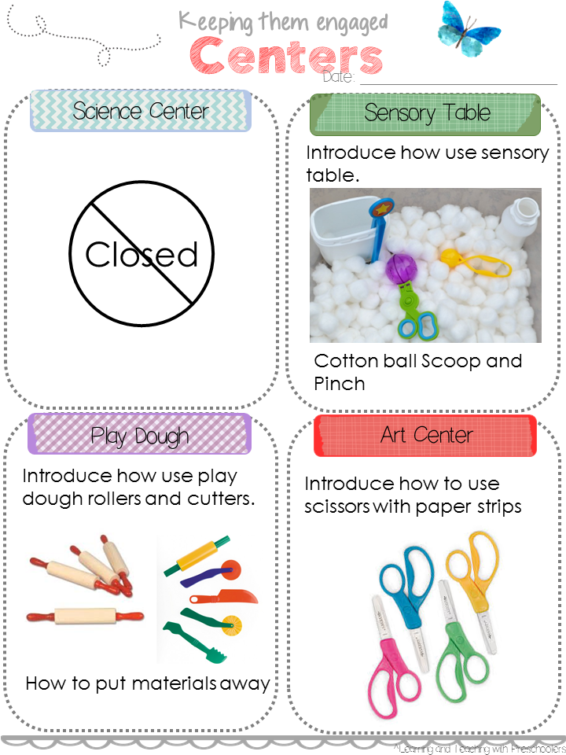
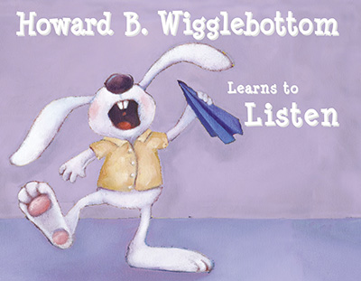
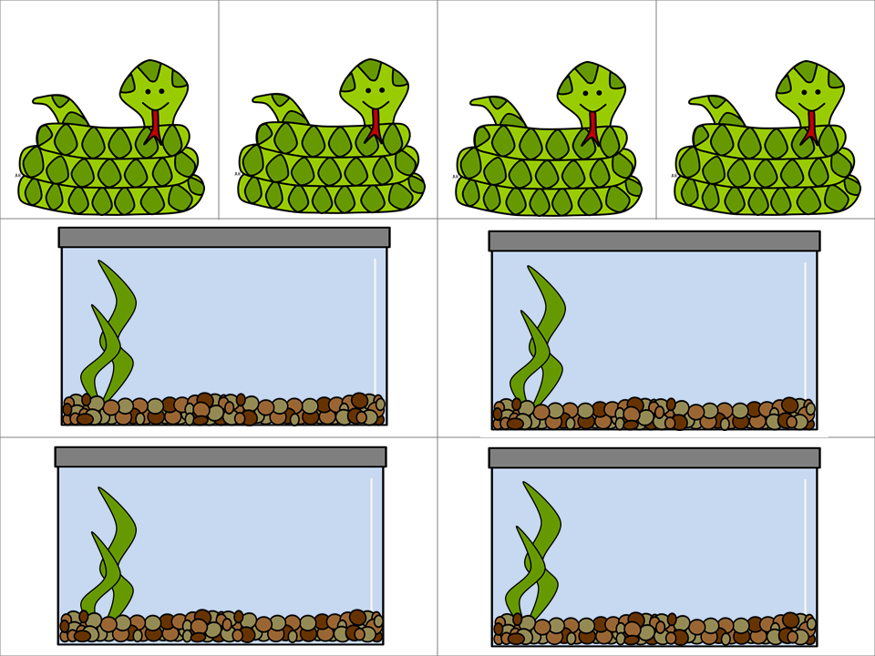
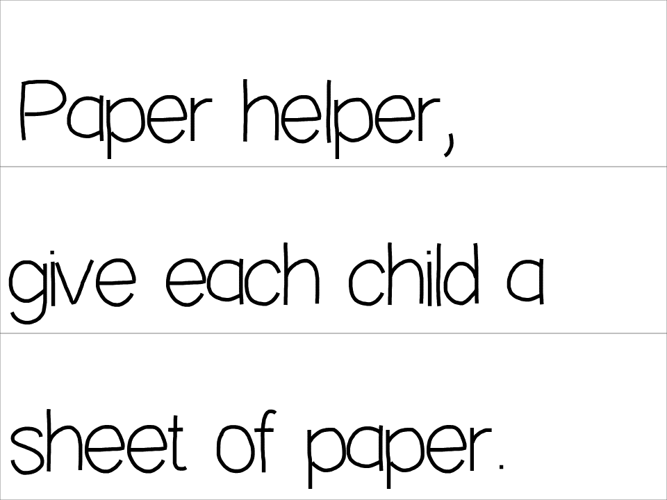
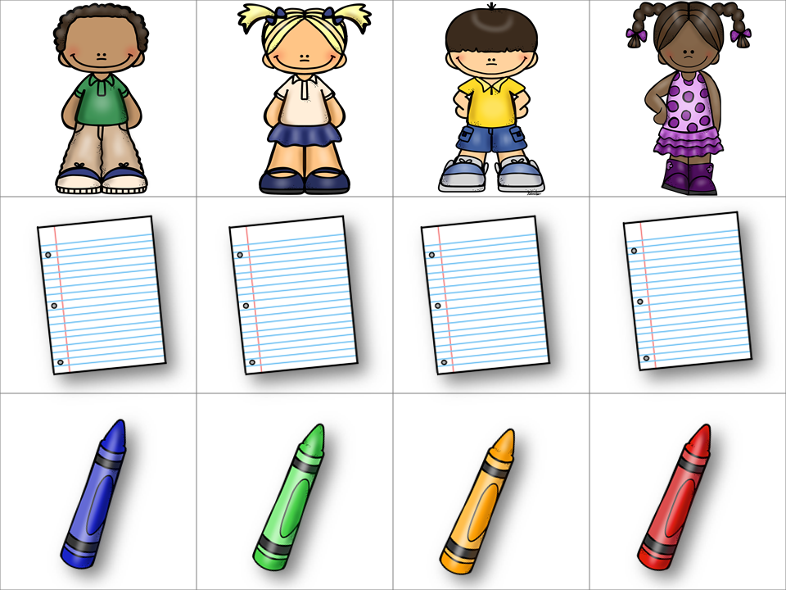
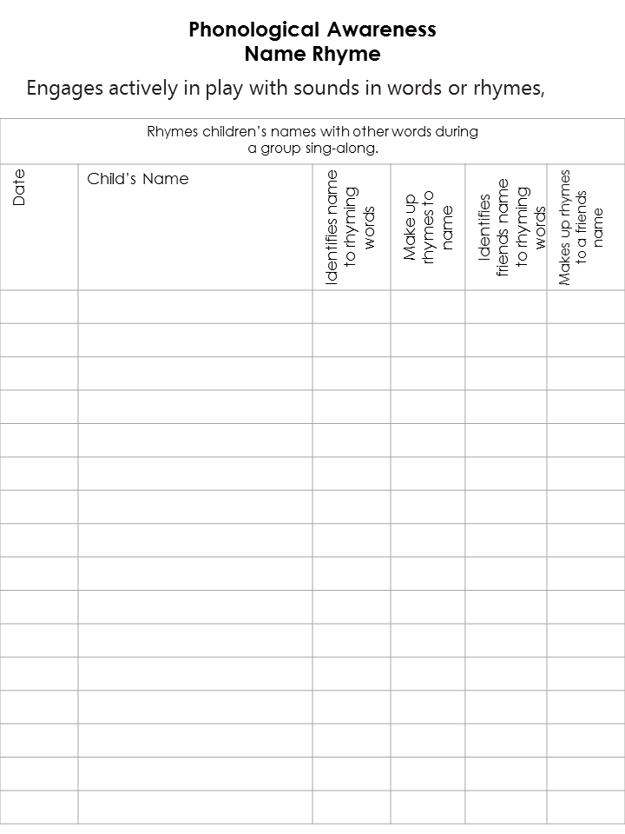
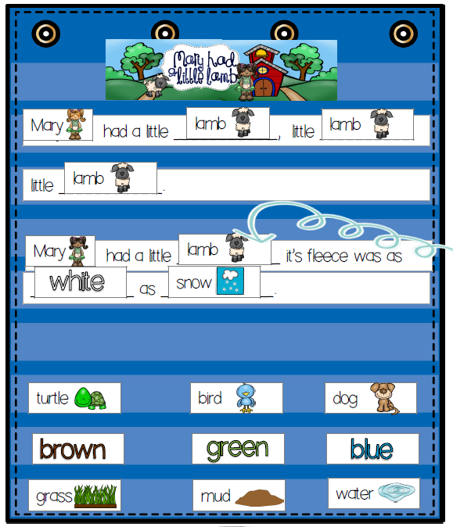
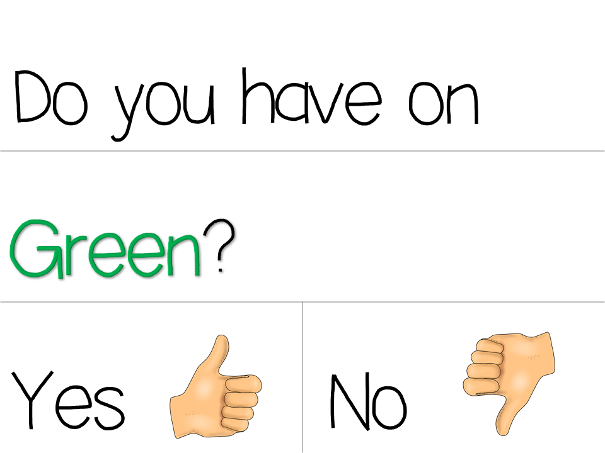
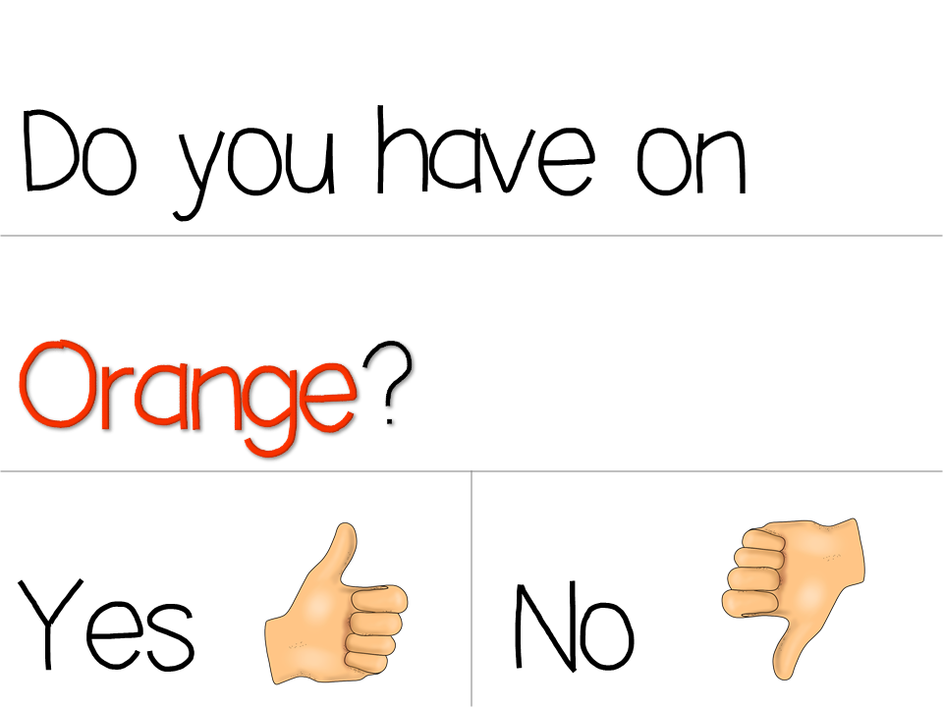
Thursday | Friday | Worktime
Social /Social Studies /Math Circle
ABC Circle/Science
Social Skills I can listen. Read: Math Number Sense: One to One Correspondence Transition: Block Balance Beam | Social Skills Group discussion on why it’s important to listen. Dictate what children say. Review Wiggle Bottoms Math Transition: Pami, Jami, Lami they all rhyme with (Tami) Assessment Phonological Awareness | Introduce the Centers
ABC Sing ABC Song with Cards Pocket Chart Mary Had a Little Lamb Transition: Daily Question | Shared Writing Sentence Frame Make a list of activities that you can do at school Transition: Daily Question
Geometry: In and Out

Slide 6
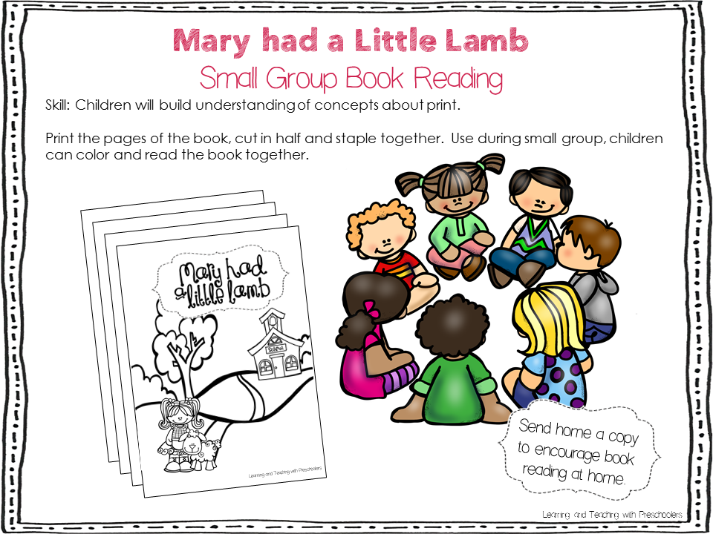
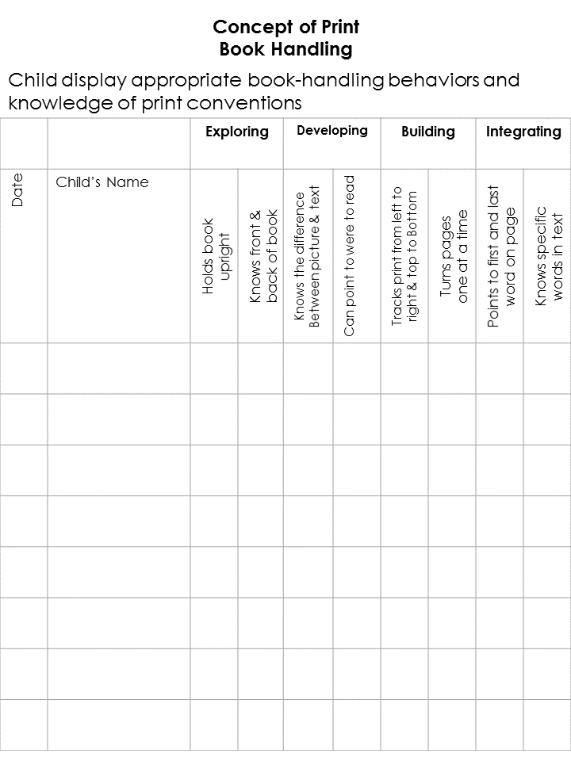
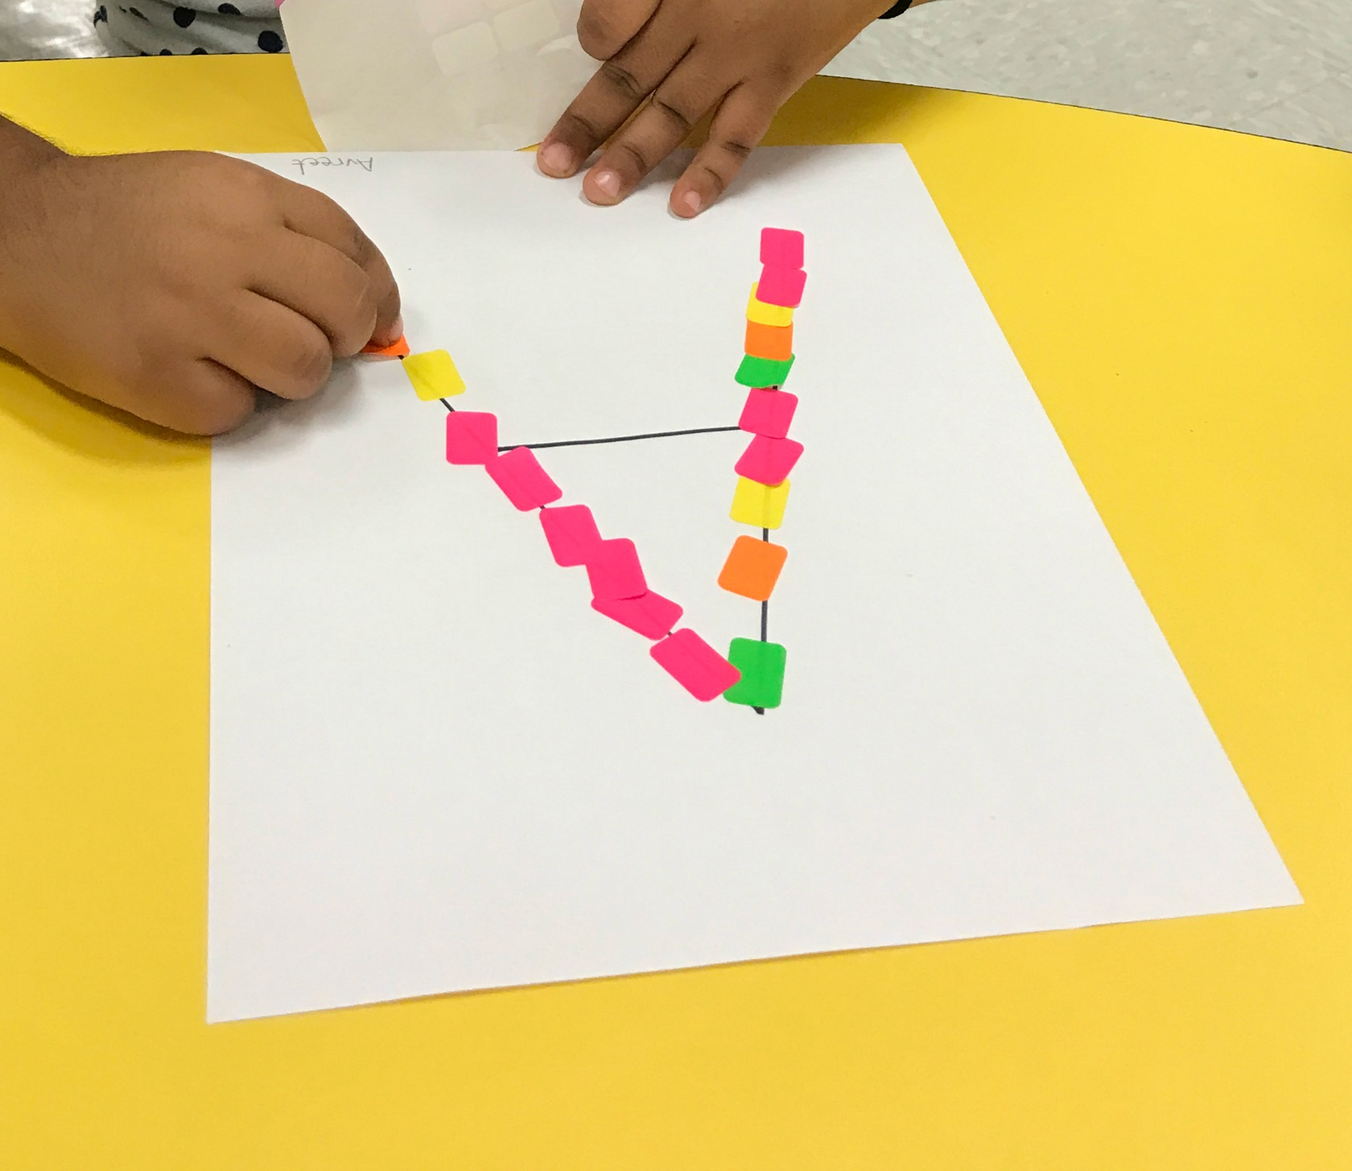
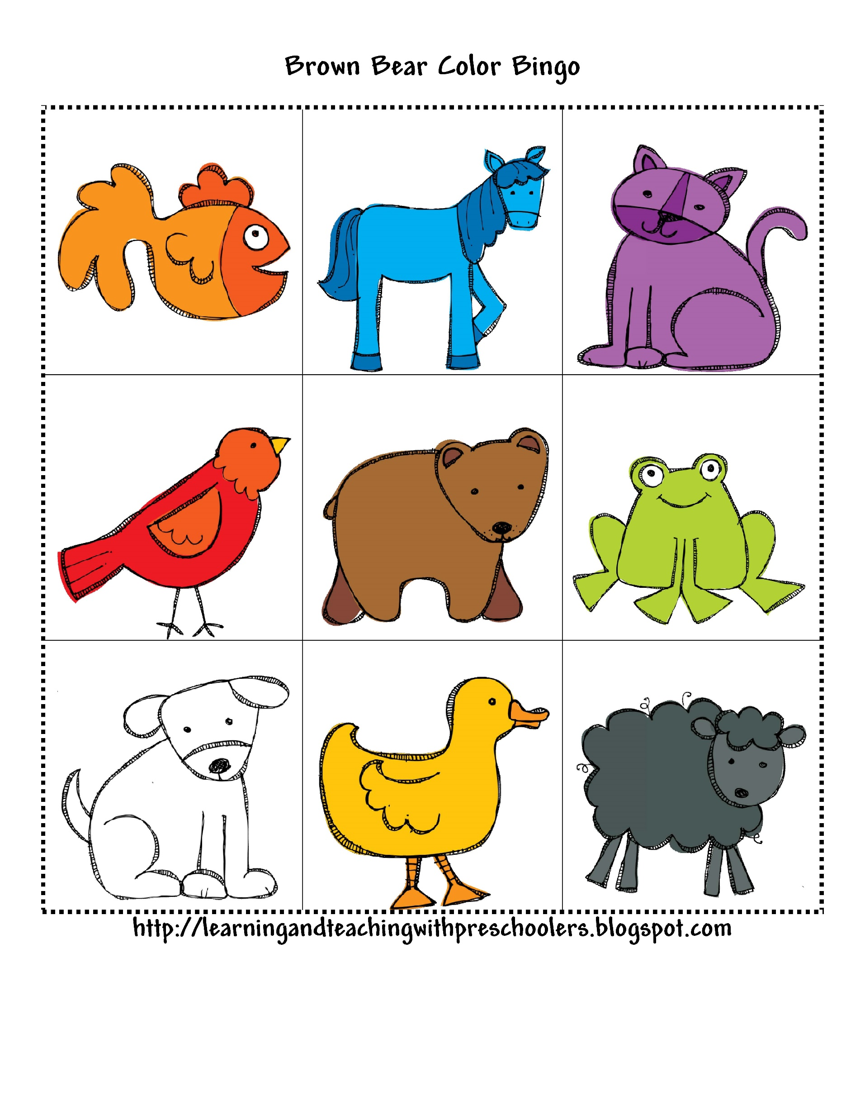
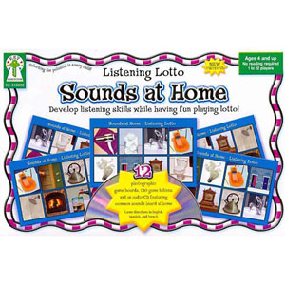
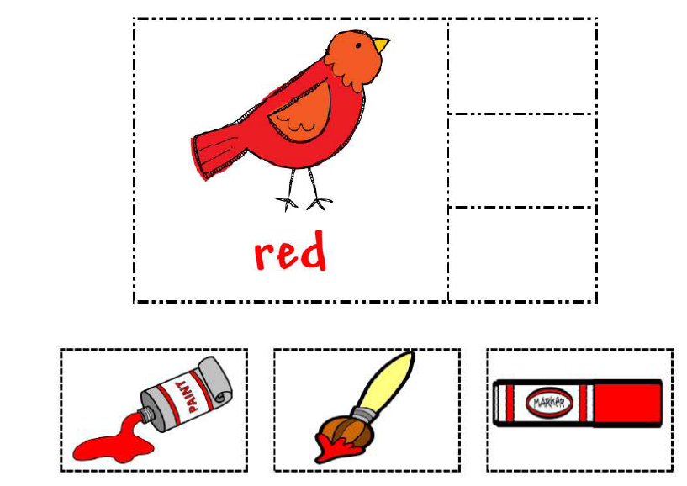
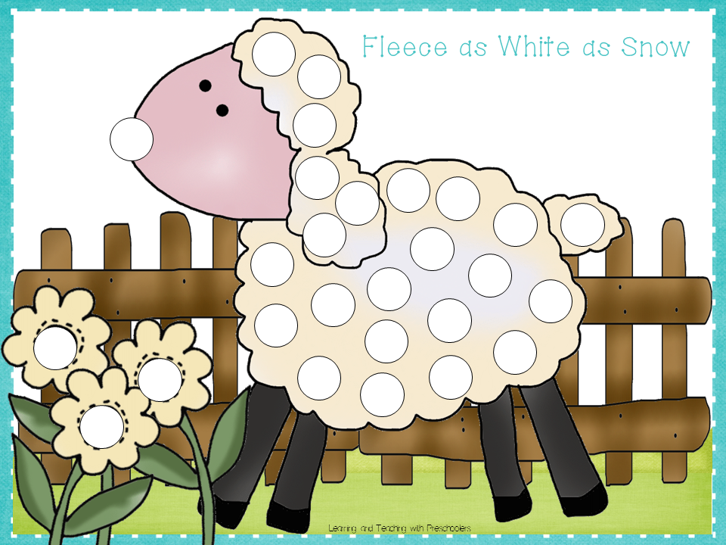
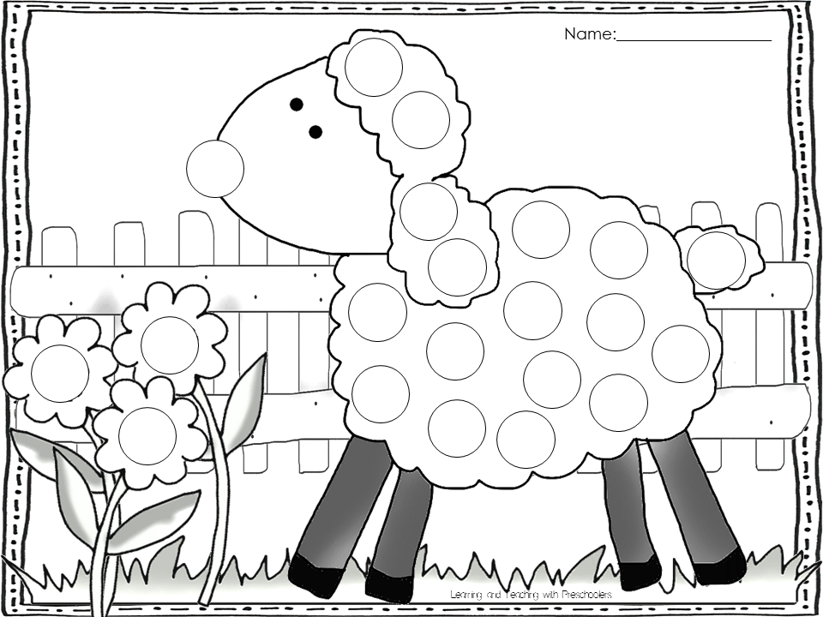
Monday | Tuesday | Wednesday
Small Group
Small Group
Small Group
Small Group
Small Group
 | Small Group Reading Assessment Concept about print
 | Brown Bear Color Bingo
 | Color Match
 | Pinch and Cover
Name Writing
Or
Name Building
Blue
Yellow
Green
Rotate activities
I can make the first letter of my name
Environmental Sound Bingo

Slide 7
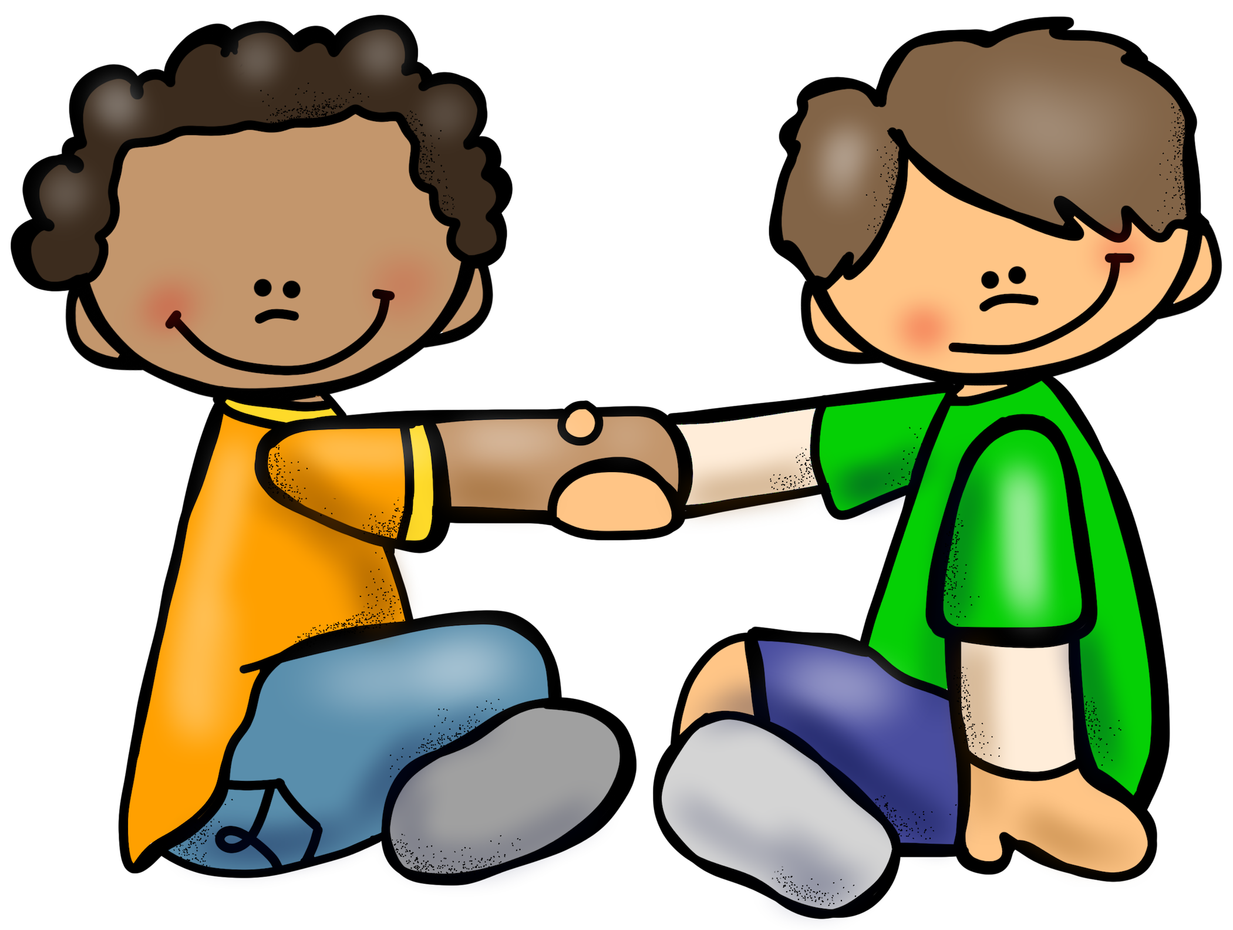
Thursday | Friday | Notes
Small Group
Small Group
Small Group
Small Group
Small Group
Small Group Reading Assessment Concept about print
Pair & Share
Turn to neighbor I like to __________ at school.

