Slide 1
Circle Time Routines
First Circle Social/Social Studies/Math | Second Circle ABC Circle/Science
Morning Song Greeting our Friends Social Lesson Song Morning Message (Math) Math Lesson Transition to Wash hands for Breakfast | Movement Song ABC Song Language/Lit Lesson Morning Message (ABC) Book Reading Transition Game to Wash hands for Snack

Slide 2
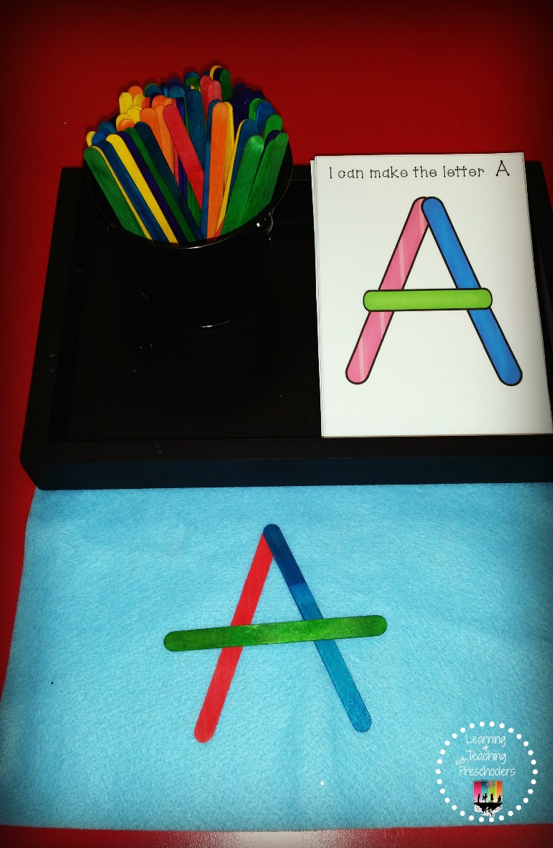
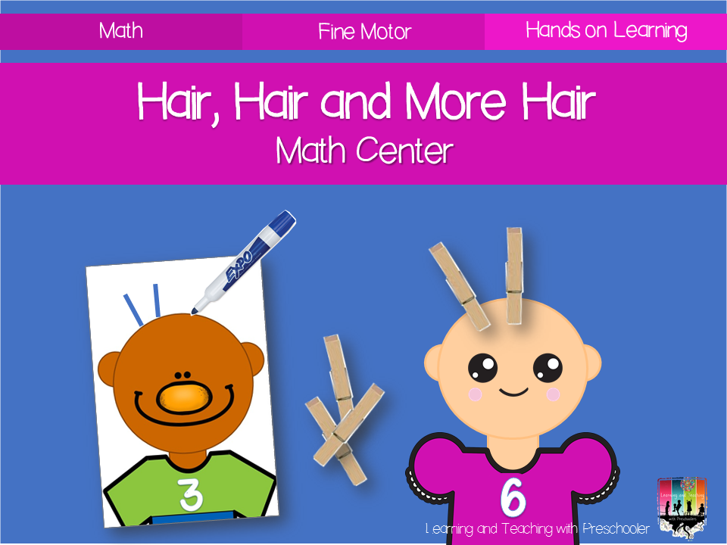
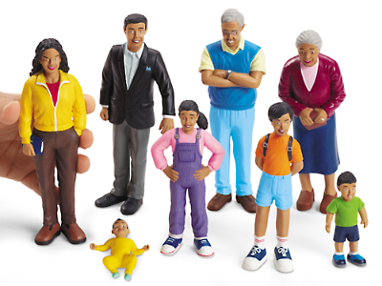
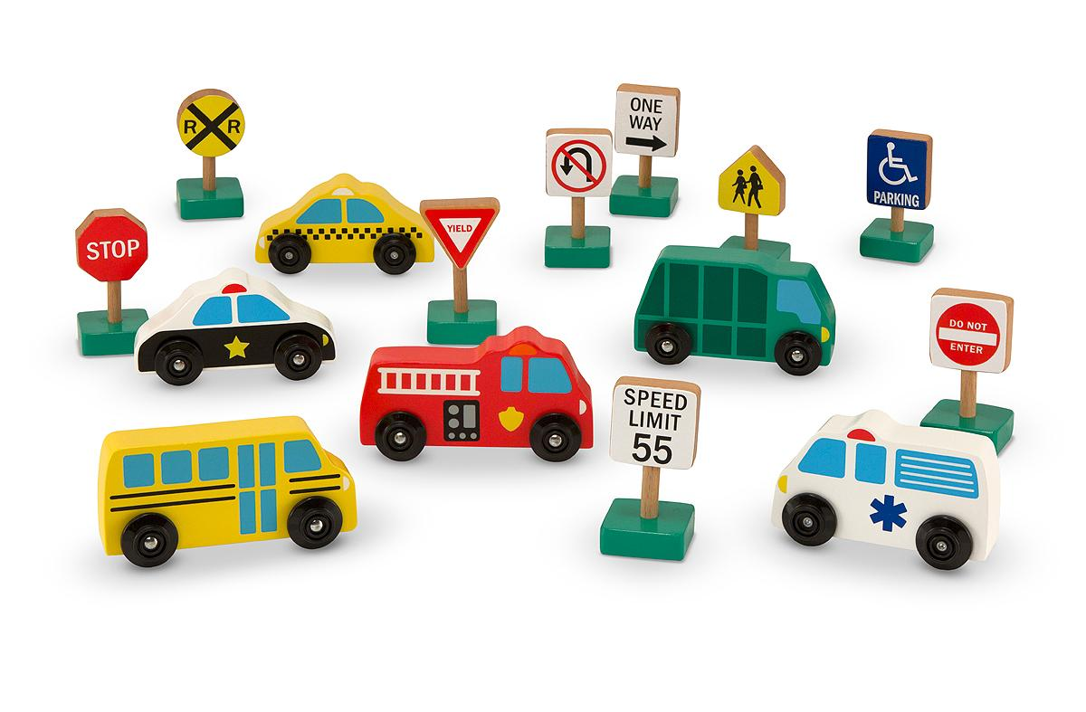
Changing
the
July
Theme: _____________________
Writing Center
Math Center
Introduce Stick Letter Cards
Introduce how to use math clipping cards.
Block Center
Dramatic Play
Introduce roles that can be played in the dramatic play center. (Mommy, Daddy, Baby, Sister, Brother and Grandparents)
Use role necklaces for each role available
Introduce people and vehicles.
How to put them away
Introduce ways to take turns.

Slide 3
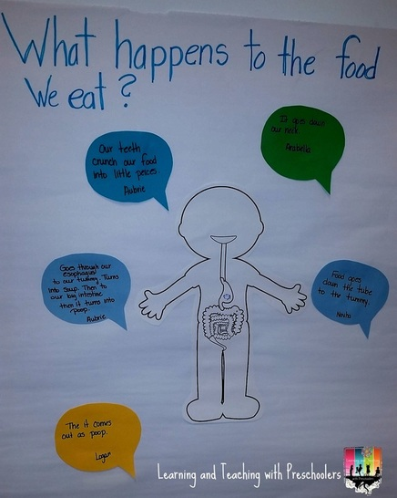
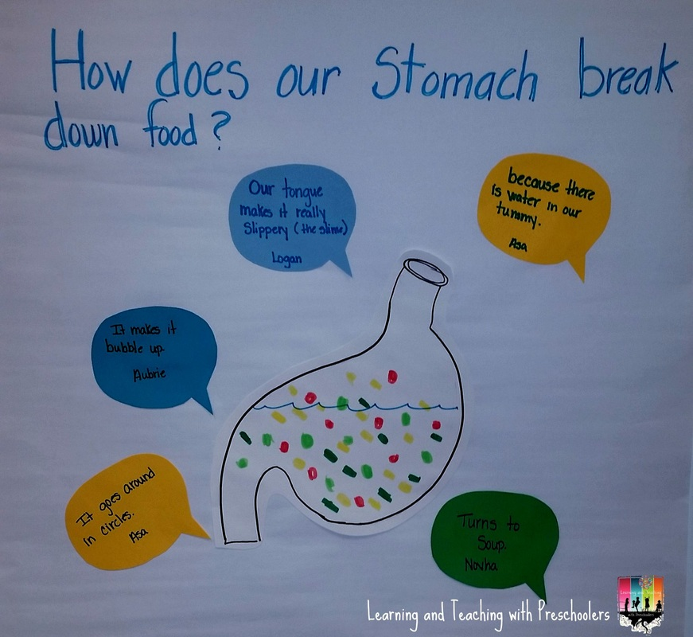
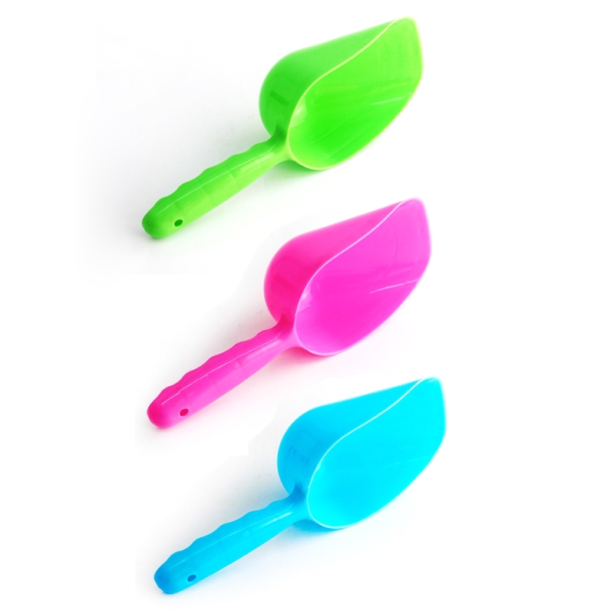
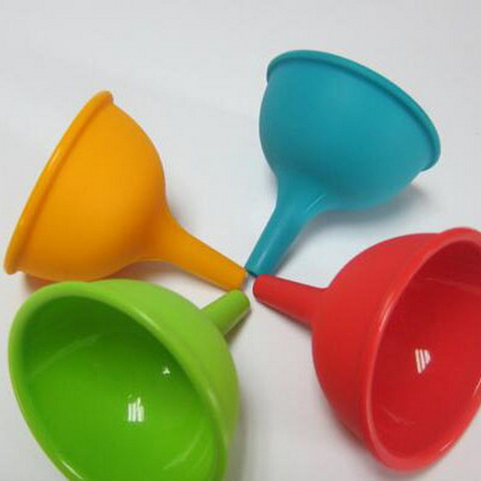
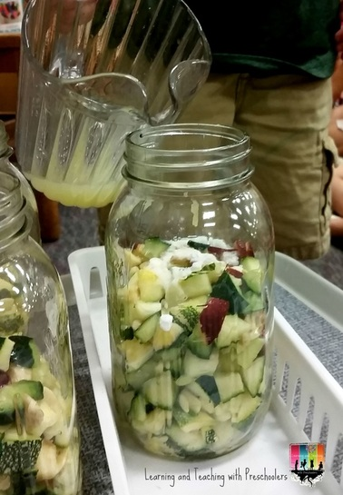
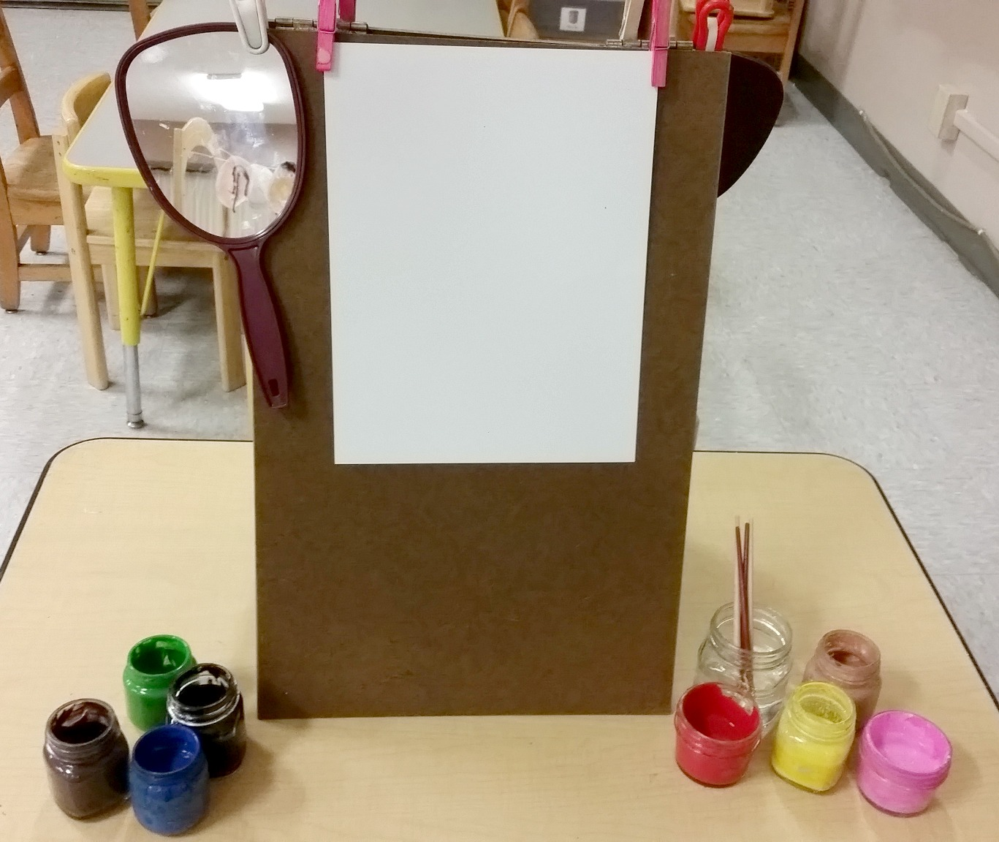
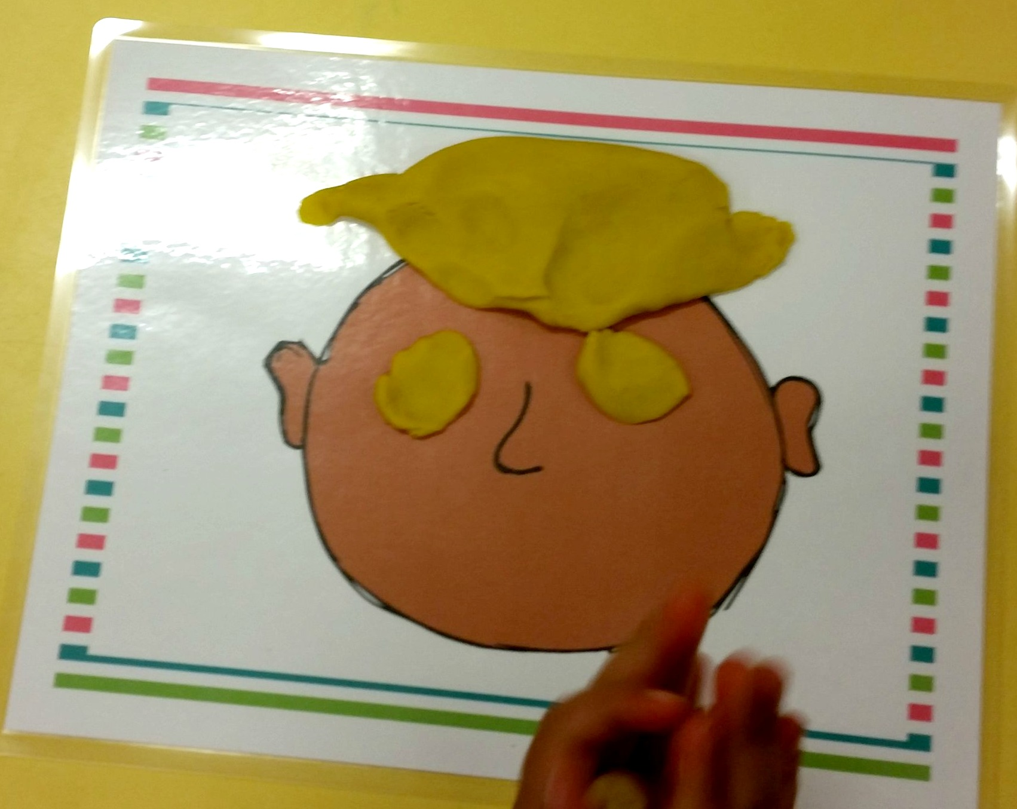
Keeping them engaged
Centers
Date: _____________________
Science Center
Sensory Table
Scoop and Pour White Rice (Add scoops and funnels)
Teach children how sweep up rich when having spills
Play Dough
Art Center
Add mirror to easel so children can paint a
self-portrait
^Learning and Teaching with Preschoolers

Slide 4
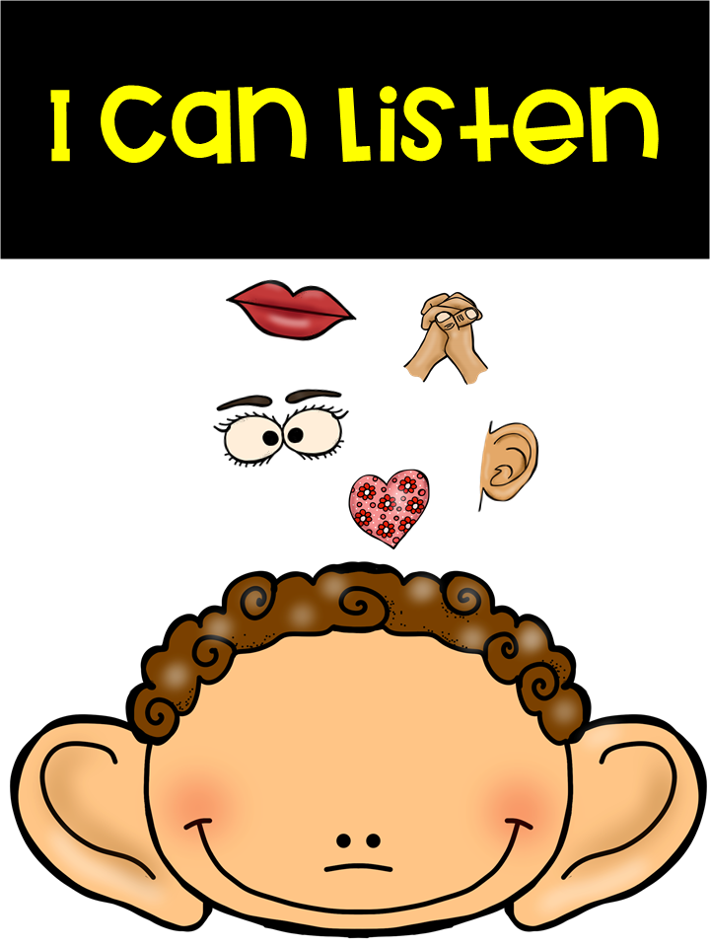
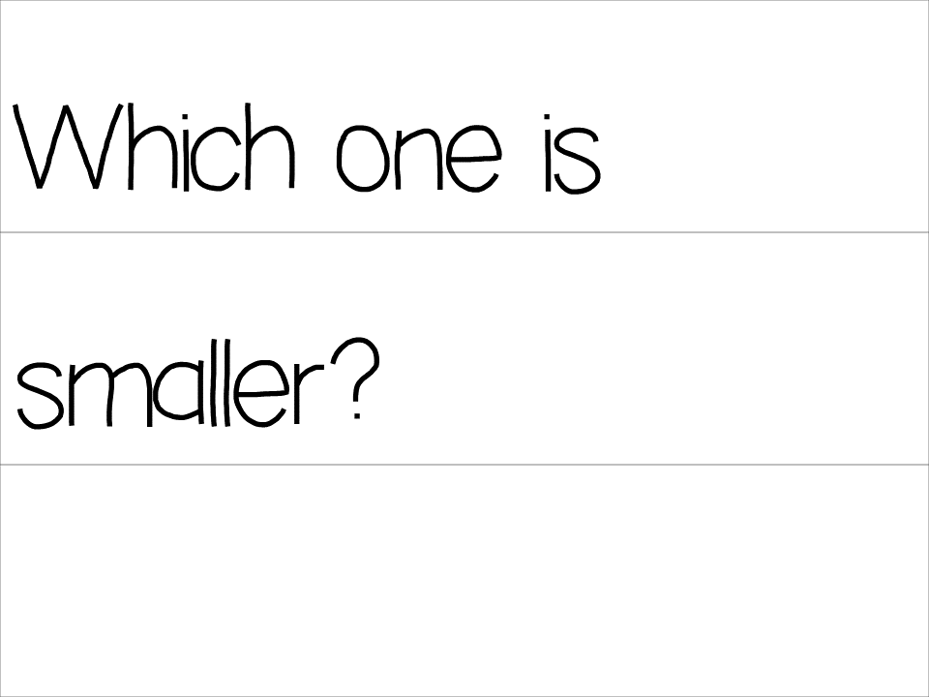
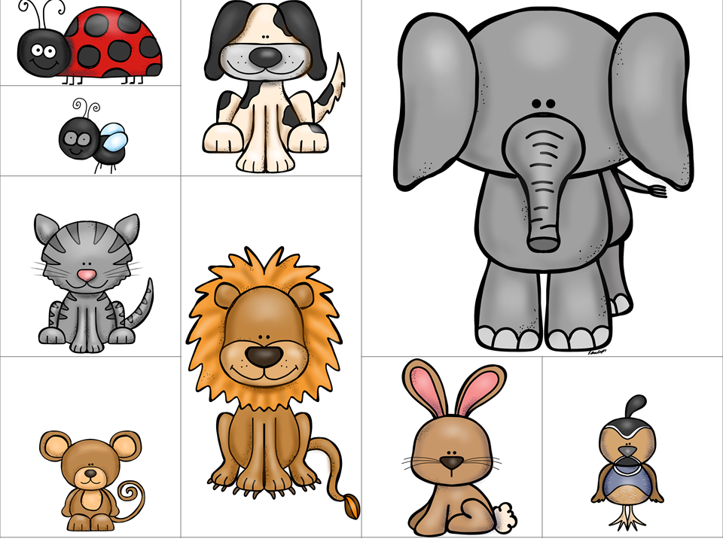
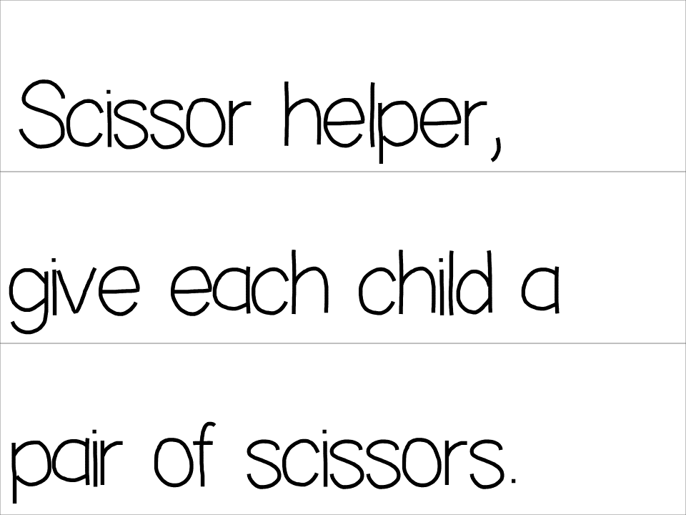
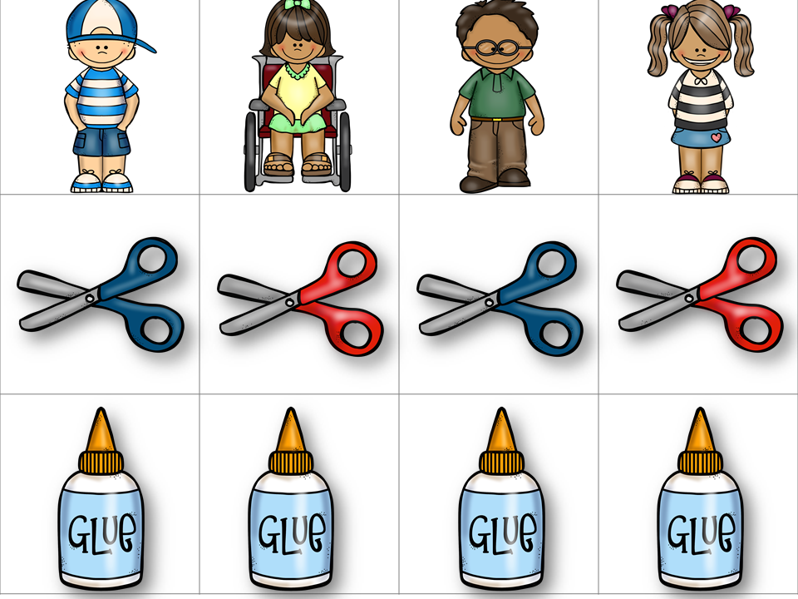
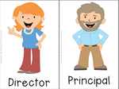
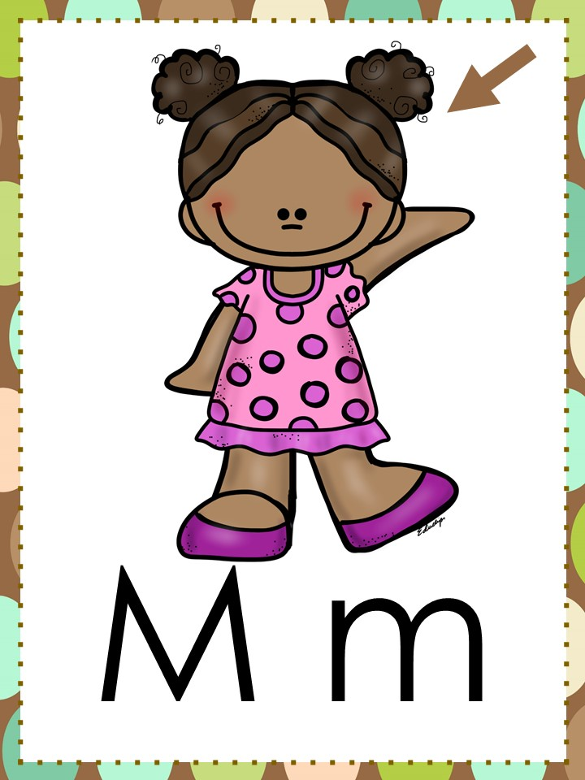
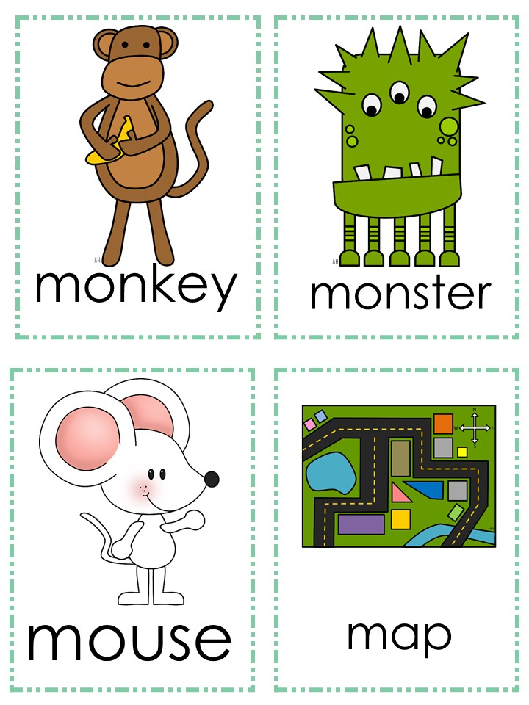
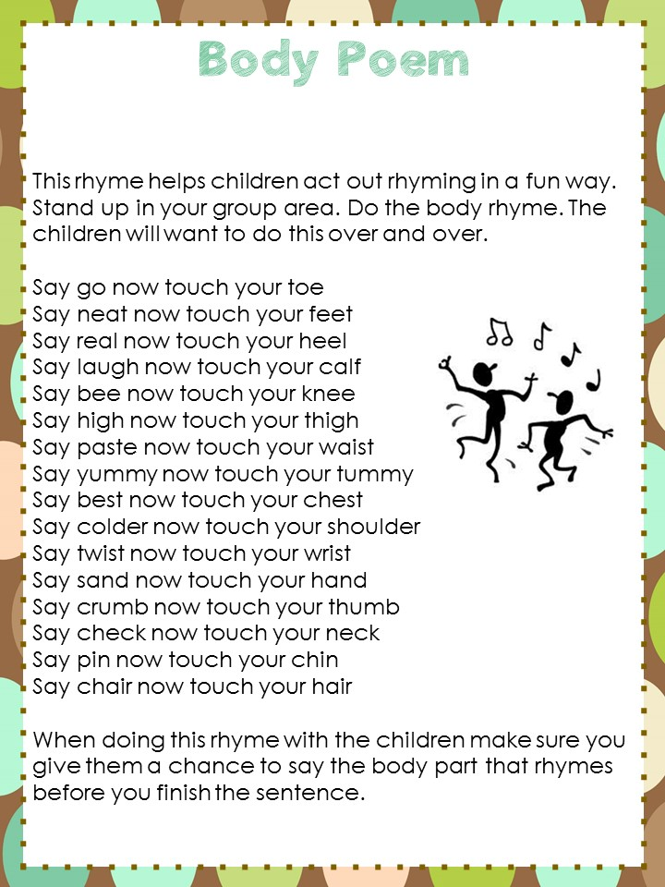
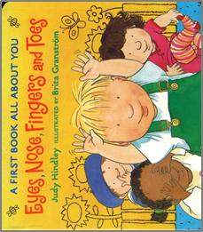
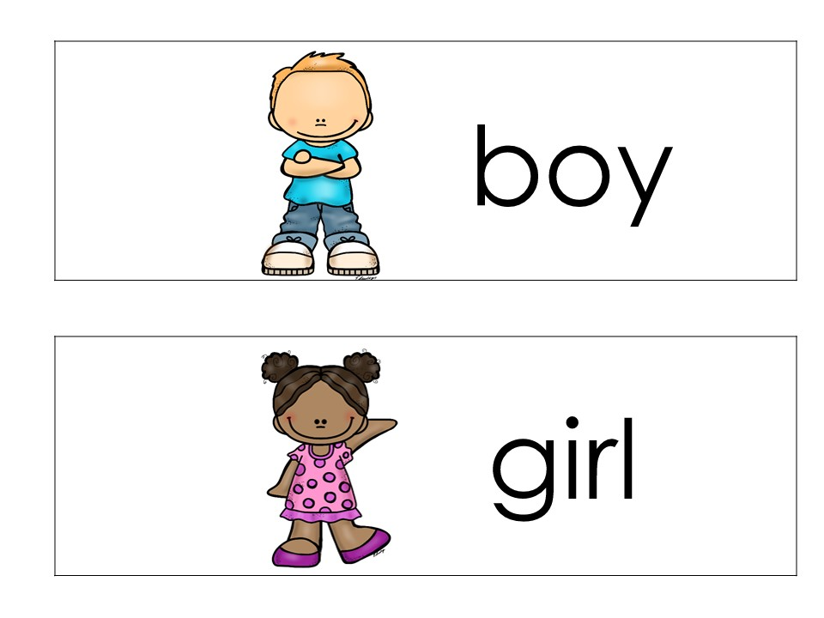
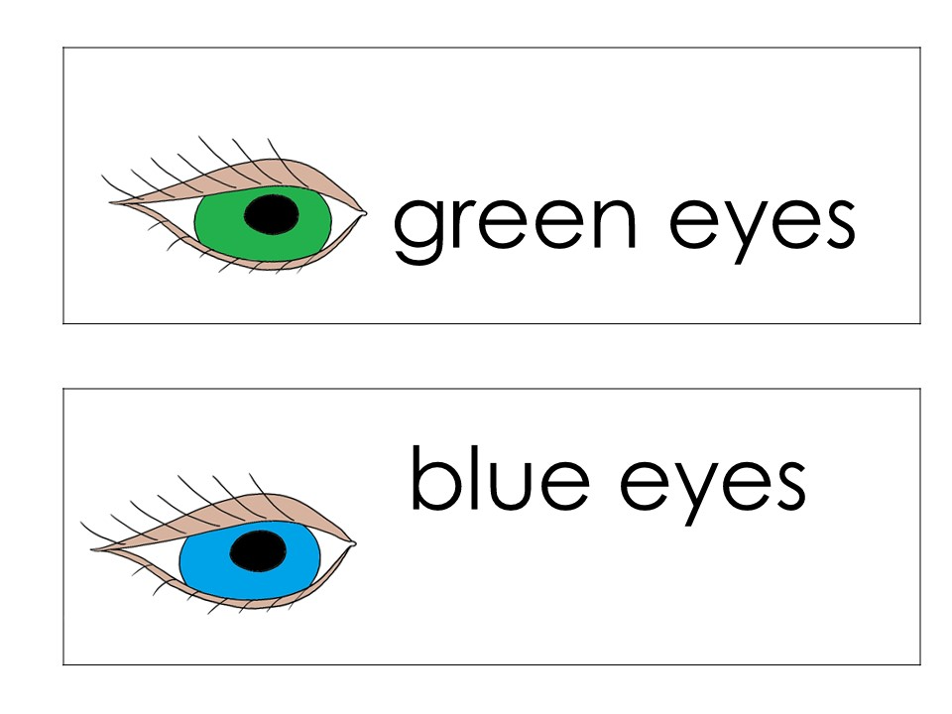
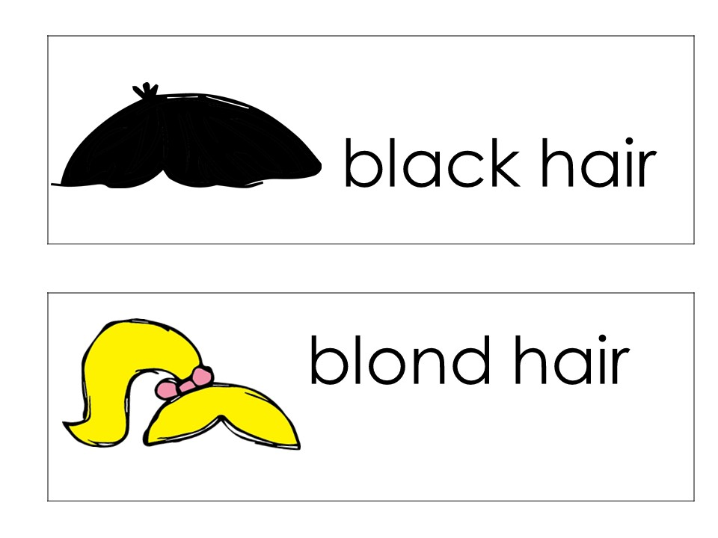
Theme:____________
Monday | Tuesday | Wednesday
Social /Social Studies /Math Circle
ABC Circle/Science
Social Skills I Learn and Play in School Role Play: How to show Kindness. Example-putting away toys, letting friends go first, cheering someone up. How else can we be kind? Math Measurement & Time: compare objects of different size, using big or small Transition: Scarf Movement to soft song (Movement Assessment) | Social Science Focusing Attention Read: I can Listen Math Number & Operations: one-to-one correspondence Transition: I can find my Name | Social Skills I Learn and Play in School Read: Social Study Read: Our School Building Vocabulary Transition: Scarf Movement to soft song (Movement Assessment)
ABC Alphabet Recognition: Sing ABC Song with Cards Introduce the Letter Mm Read: The Way I Feel Transition: Daily Question Boy or Girl | Science Read Transition: Daily Question Eye Color | ABC Phonological Awareness Body Rhyme Read: Transition: Daily Question Hair Color

Slide 5
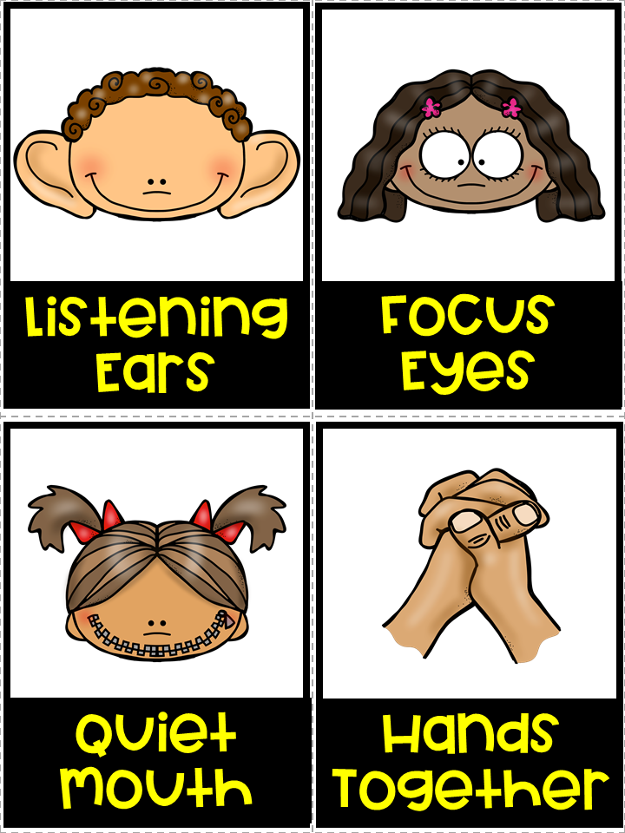
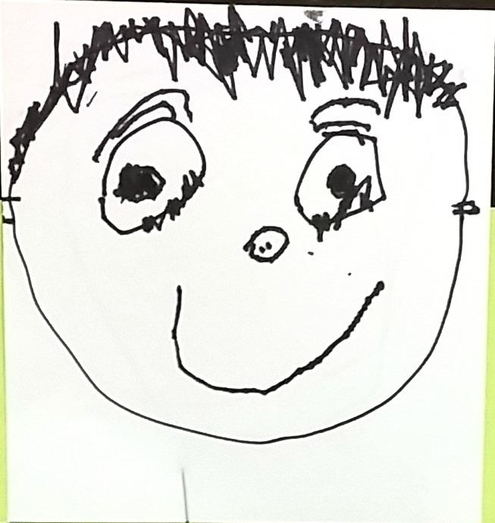
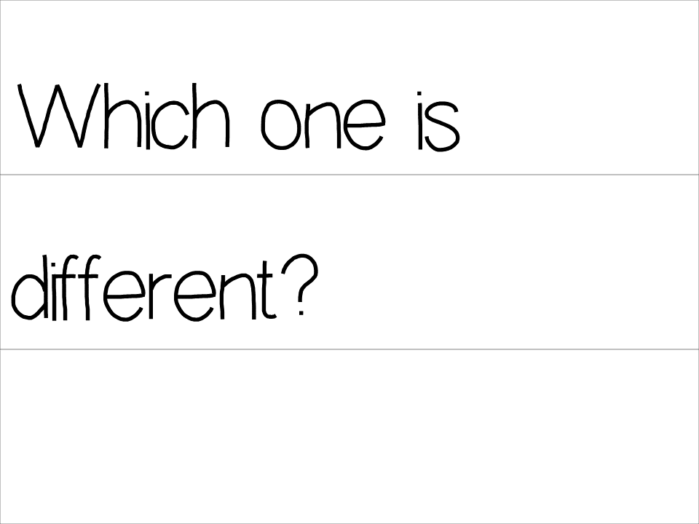
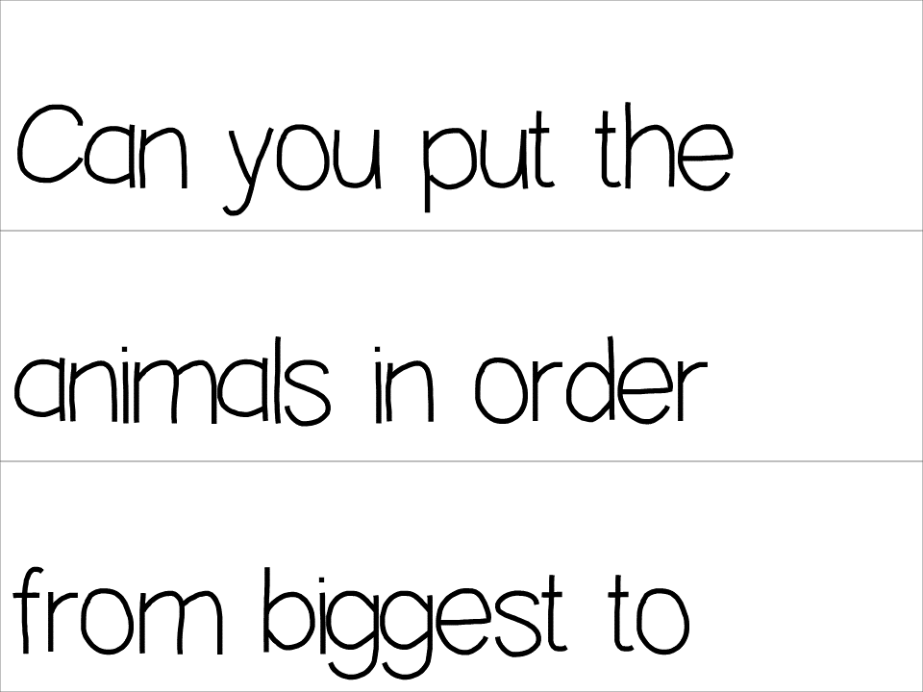
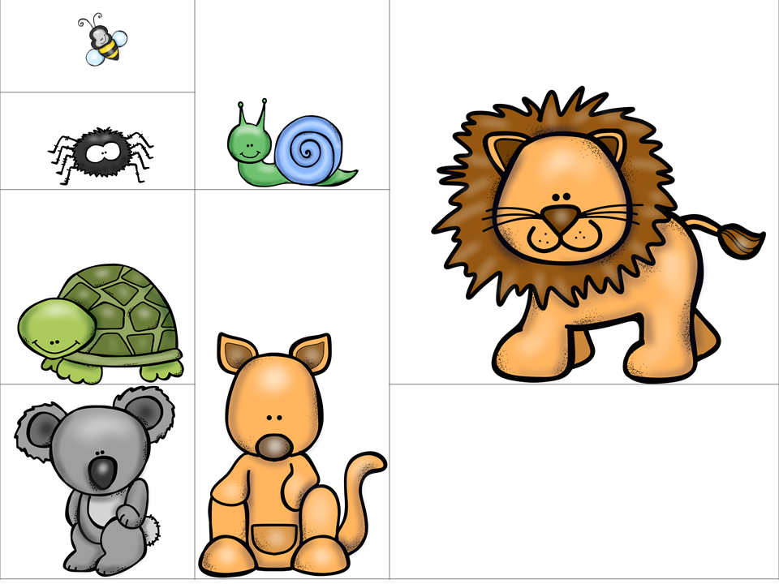
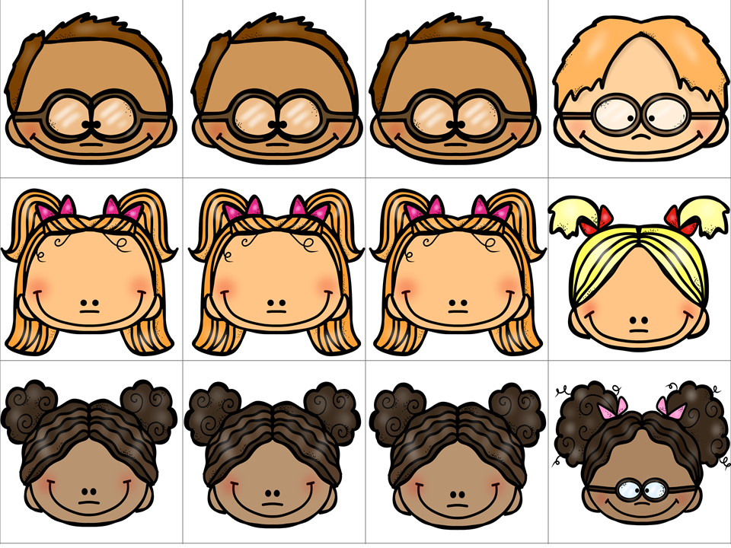
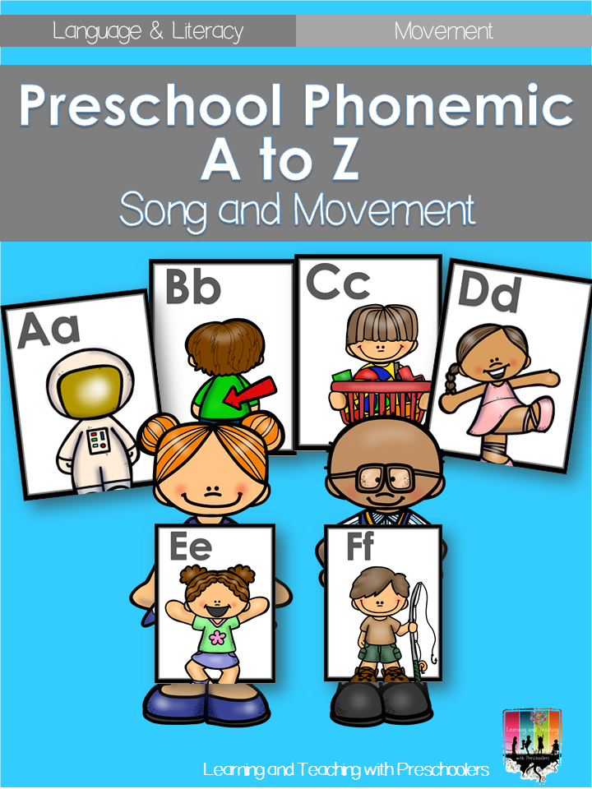
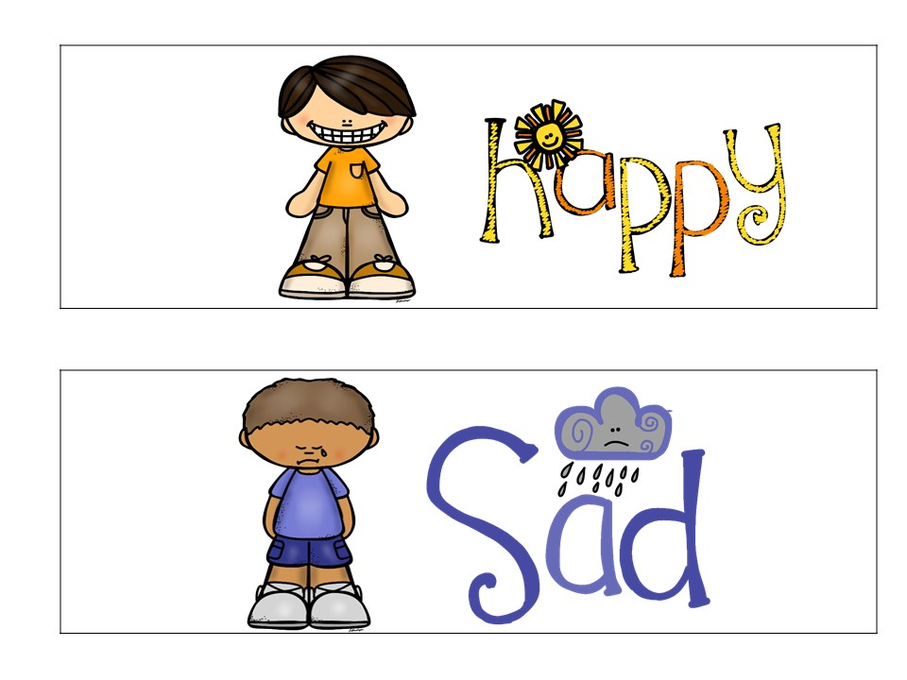
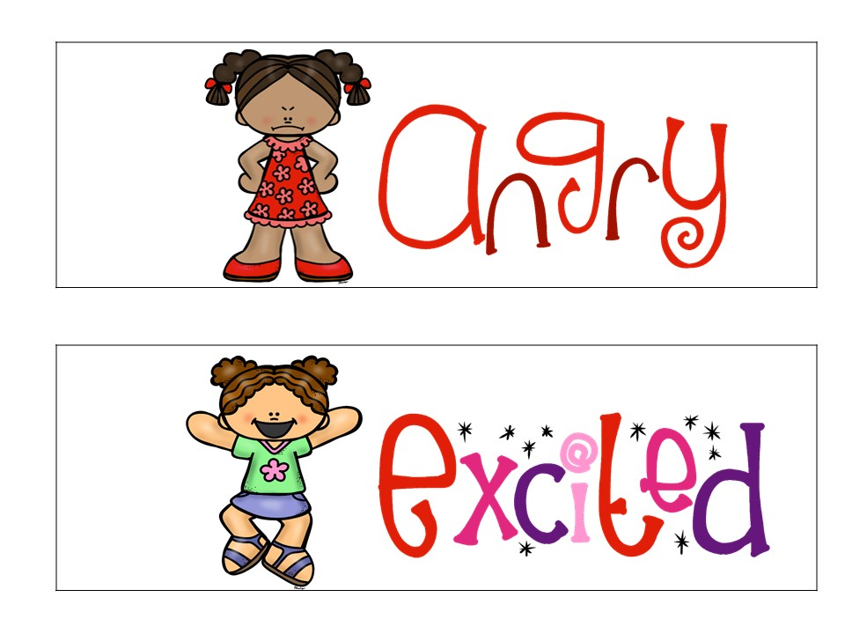
Thursday | Friday | Worktime
Social /Social Studies /Math Circle
ABC Circle/Science
Social Skills Focusing Attention Show me … Have children demonstrate Each active listening skill Math Patterns & Algebra: visually discriminate Transition: I can find my Name | Social Skills I Learn and Play in School Group discussion about ways we can be kind to our friends. Math Transition: Hocky Pockey (Small Group of kids) Naming a few body parts and doing the Hocky Pocky | Self Portraits Use mirrors, sharpies, crayons and watercolors.
ABC Sing ABC Song with Cards Read: The way I Feel Transition: Daily Question Today I Feel | Shared Writing Sentence Frame Make a list of Make a list: What makes you happy? Transition: I can write the letter in my name. Large sheet of paper for children to write on.
Measurement & Time:
compare objects of different size, using big or small

Slide 6
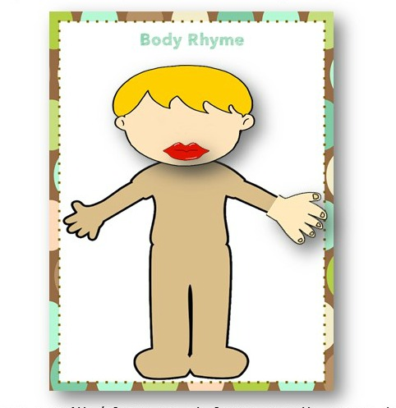
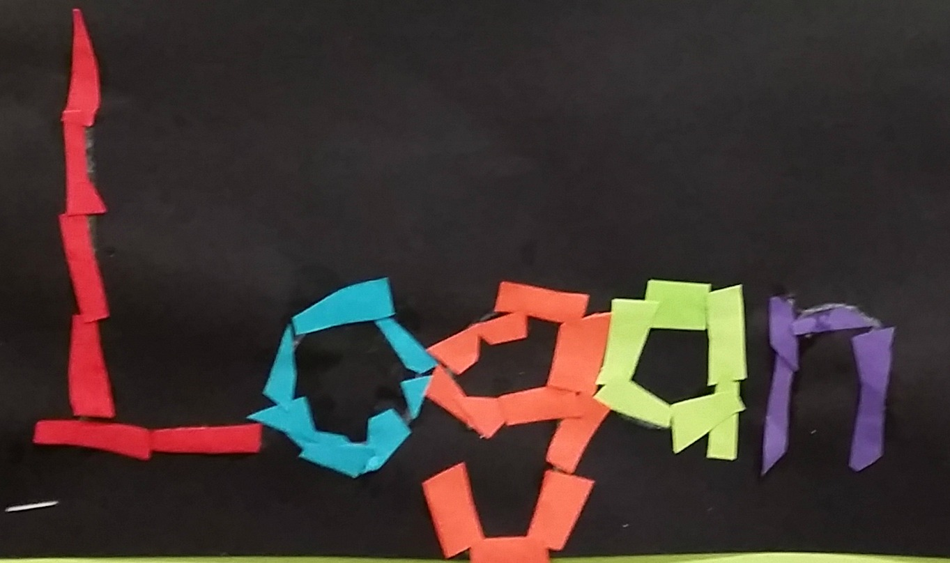
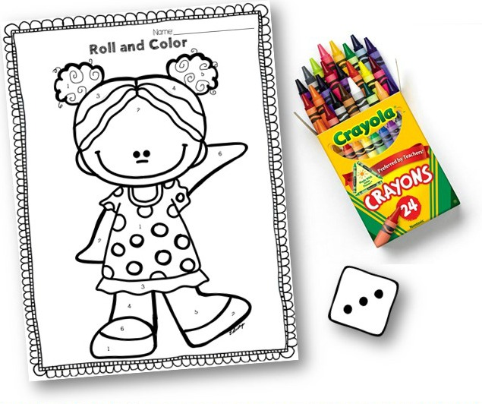
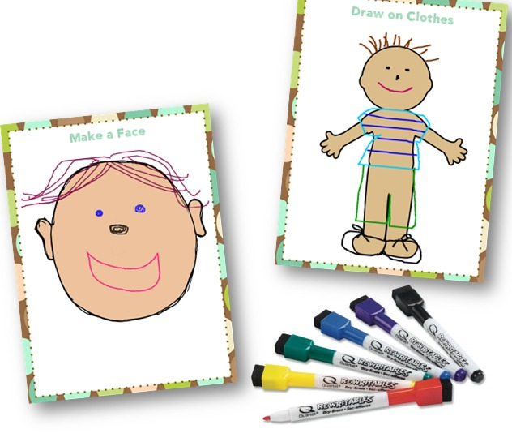
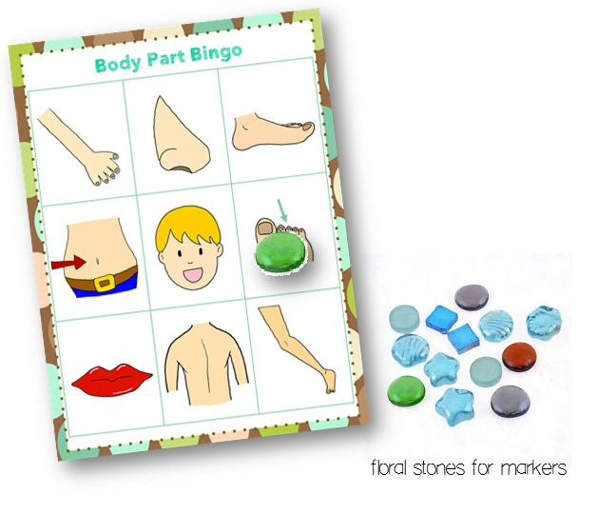
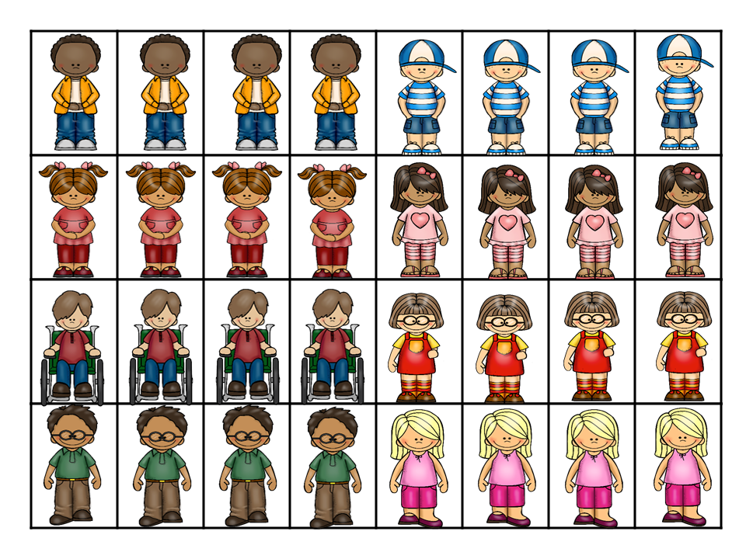
Monday | Tuesday | Wednesday
Small Group
Small Group
Small Group
Small Group
Small Group
 | Body Rhyme Assessment Phonological Awareness
 | Roll and Color Assessment Number Recognition (1-6)
 | Body Part Bingo
 | Sorting Kids Assessment Classification
Name Writing
Or
Name Building
Blue
Yellow
Green
Rotate activities
Collage name
Draw and Wipe Mats

Slide 7
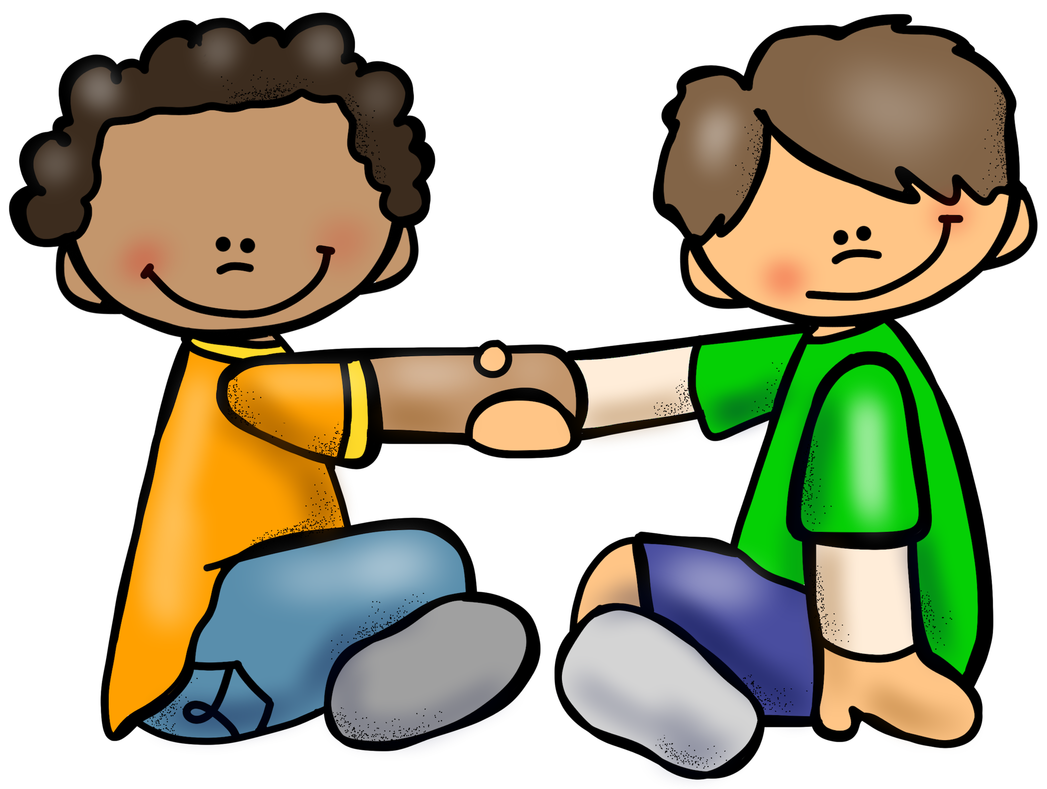
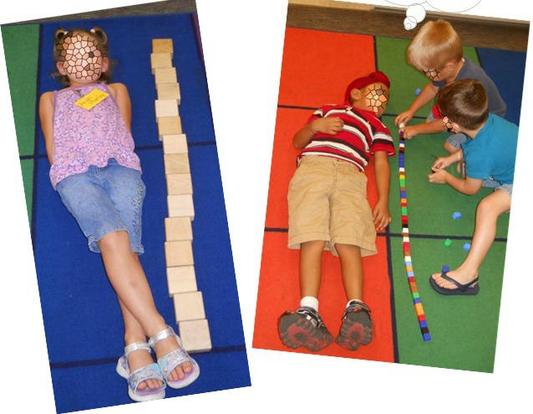
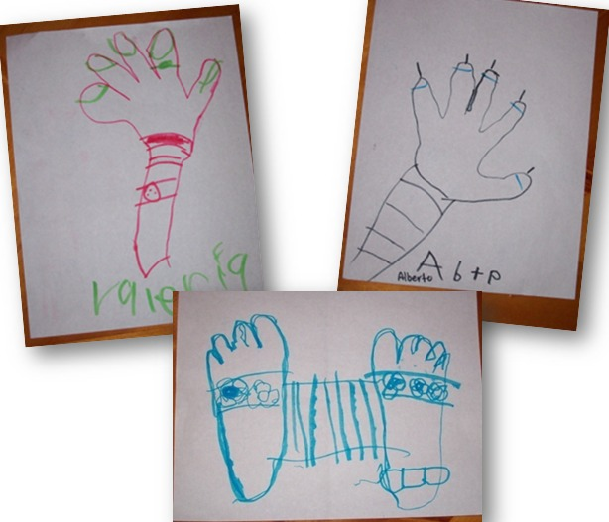
Thursday | Friday | Notes
Small Group
Small Group
Small Group
Small Group
Small Group
How Many Tall Assessment Measurement
Body Part Tracing
Pair & Share
Turn to neighbor It makes me happy when I ___________.

